Slide 1

Clickers
Jennifer Muzyka, Centre College
Active Learning in Organic Chemistry, 2017

Slide 2
What is your experience with clickers
Haven’t tried them but am interested
Use them occasionally
Use them regularly
Haven’t really considered them
Opposed to their use

Slide 3
If you use clickers, what brand do you use?
Notes:
Innovators (2.3%); Early Adopters (14.6%); CHASM; Early Majority (34.1%); Late Majority (34.1%); Laggards (16.9%)

Slide 4
Why do instructors use clickers?
Notes:
Literature suggests clickers are used most in large classes (>55) in introductory courses (Gibbons, 2017). No evidence that faculty member rank (age) is a factor in clicker adoption.

Slide 5
Literature about clicker usage
Improves student success (Poulis, 1998)
Maintain interest (Miller, 2003)
Encourage participation (James, 2006)
Facilitate active engagement (Boyle 2003)
Encourage student reflection (Boyle 2003)
Notes:
Formative assessment associated with clickers improves student success. Poulis (1998) found passing rate of 85% when clickers used, compared to 60% without clickers.
Bunce (2006) reported no improvement with clickers vs online quizzes BUT the histogram was visible to students while answering with clickers.
Miller (2003) reports that health professionals are able to maintain interest in presentations more readily when clickers are used

Slide 6
Educational frameworks
Behaviorism, 1960’s and 70’s
Constructivism, present
  Student collaboration
  Empowering students
Notes:
Judson and Sawada, 2002

Slide 7
What barriers prevent you from adopting clickers?

Slide 8
Question types
Multiple choice
Numerical
Text
Highlight structure
Draw structure
Add arrows

Slide 9
Sources of questions
Textbook resources from publishers
Suzanne Ruder’s Clickers in Action: Active Learning in Organic Chemistry
ChemEdX Qbank https://www.chemedx.org/JCEDLib/QBank/collection/ConcepTests/)
Instructor-written
OrganicERs website
Student generated
Portland State University (http://web.pdx.edu/~wamserc/ConcepTests/)

Slide 10
Peer Instruction (Mazur)
Short lecture
Students answer clicker question individually
Instructor views histogram but doesn’t share with students
Students discuss question with others who disagree
Students answer clicker question again
Notes:
60% correct response is ideal. Higher responses indicate questions aren’t adequately challenging (MacArthur 2013)

Slide 11
Assessing-to-Learn (A2L) or Question-driven instruction
Students discuss question in small groups before answering
Instructor displays histogram of responses
Instructor moderates whole class discussion
Three to four cycles per 50 minute class period
Each question has content goal, process goal, and metacognitive goal
Notes:
Read about A2L (DuFresne and Beatty papers)
Threefold purpose for every question – content goal, process goal, and metacognitive goal
Boyle and Nicol studies said Students prefer PI over A2L, but I’m not sure they were careful with implementation of A2L

Slide 12
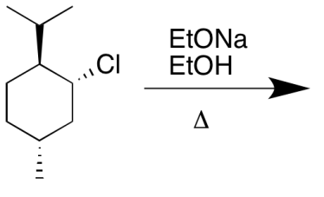
Predict the major product.

Slide 13
How many stereogenic centers?
Notes:
Kevin Shea’s idea, used with Learning Catalytics, have students label the stereogenic centers.
With Nearpod, can have students LABEL the stereogenic centers.

Slide 14
Which is the most stable conformer of cis-1-chloro-3-isopropylcyclohexane?

Slide 15
What is the order of stability from most to least stable?
2-methyl-2-pentene
(Z)-hex-2-ene
2,3-dimethylbut-2-ene
Hex-1-ene
(E)-hex-2-ene

Slide 16
How should the mechanism arrows be written? (Enter a sequence of numbers.) The 1st number is the base of a curved arrow. The second number is the head. If there is a second arrow, the 3rd number would be the base and the 4th number would be the head.

Slide 17
How should the mechanism arrows be written? (Enter a sequence of numbers.) The 1st number is the base of a curved arrow. The second number is the head. If there is a second arrow, the 3rd number would be the base and the 4th number would be the head.
Notes:
Ruder (2008)

Slide 18
Propose a multi-step synthesis to convert cyclohexene to ethoxycyclohexane.

Slide 19
11 12 13 OR 11 9 13

Slide 20
Synthesize 3-methylhex-3-ene from butan-2-ol and 1-bromopropane by entering the number for the correct reagents for the letters in the boxes. You will need to determine the identity of Compounds U, V, and W along the way. Use each reagent only once.
1. (1. LiAlH₄, ether 2. H₃O⁺)
2. Na₂Cr₂O₇, H₂SO₄
3. Compound V
4. Compound W
5. Ph₃P
6. BuLi, ether
7. Mg, ether
8. NaOEt, EtOH

Slide 21
Synthesize 3-methylhex-3-ene from butan-2-ol and 1-bromopropane by entering the number for the correct reagents for the letters in the boxes. You will need to determine the identity of Compounds U, V, and W along the way. Use each reagent only once.
A=2; B=4; C=5; D=6
1. (1. LiAlH₄, ether 2. H₃O⁺)
2. Na₂Cr₂O₇, H₂SO₄
3. Compound V
4. Compound W
5. Ph₃P
6. BuLi, ether
7. Mg, ether
8. NaOEt, EtOH

Slide 22
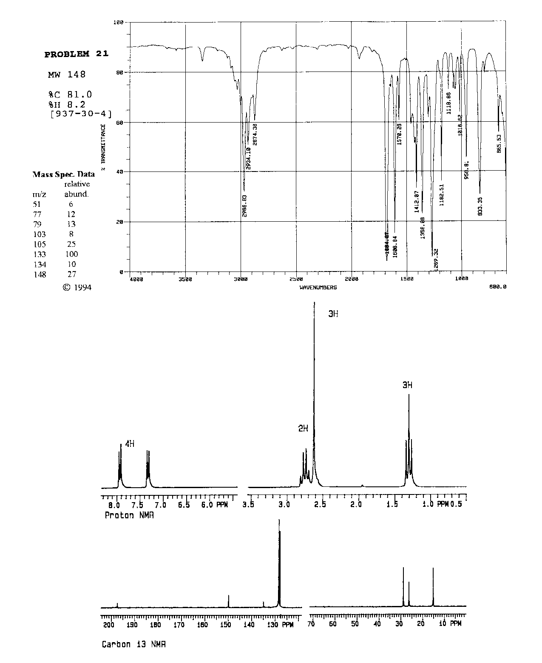
Make a multiple choice question here by gathering student responses to the question and then writing them on the board in the classroom.

Slide 23
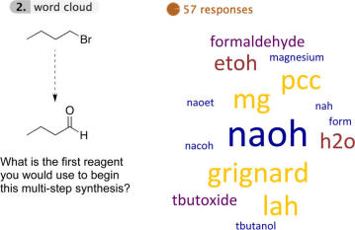
Word clouds
Shea, Kevin, “Beyond Clickers, Next Generation Classroom Response Systems for Organic Chemistry,” J. Chem. Educ. 2016, 93, 971-974.
Notes:
Kevin Shea 2016 JCE

Slide 24
Other Options
Colored cards/sheets of paper
Plickers (http://plickers.com)
Students draw & show answers
iQlickers, Lee, A.W.M., “Lecture Rule No. 1: Cell Phones ON, Please! A Low-Cost Personal Response System for Learning and Teaching,” J. Chem. Educ. 2013, 90 (3), 388-389.
Notes:
Lasry (2008) found that colored cards worked as well as clickers to improve student performance

Slide 25
Resources
Teaching with Classroom Responses Systems, Derek Bruff, Jossey-Bass, 2000
Clickers in Action: Active Learning in Organic Chemistry, Suzanne Ruder, Norton, 2013
“Peer Instruction: Ten Years of Experience and Results,” by Catherine H. Crouch and Eric Mazur, Am. J. Phys. 2001, 69, 970-977.
Vince Maloney’s questions on OrganicERs

Slide 26
References

