Slide 1
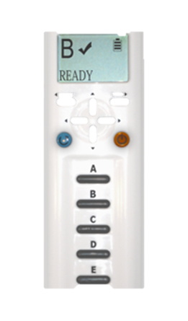
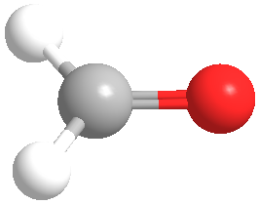
Classroom Response Systems (CRS) in Organic Chemistry
Vincent Maloney
Indiana U. Purdue U. Fort Wayne
Active Learning in Organic Chemistry Workshop

Slide 2
Outline
Structure of presentation
Benefits of classroom assessment techniques
  CRS
Implementation overview
Question types
Best practices/Potential Issues

Slide 3
Structure of Presentation
Essentially same as “traditional lecture”
Lecture interspersed with CRS questions

Slide 4
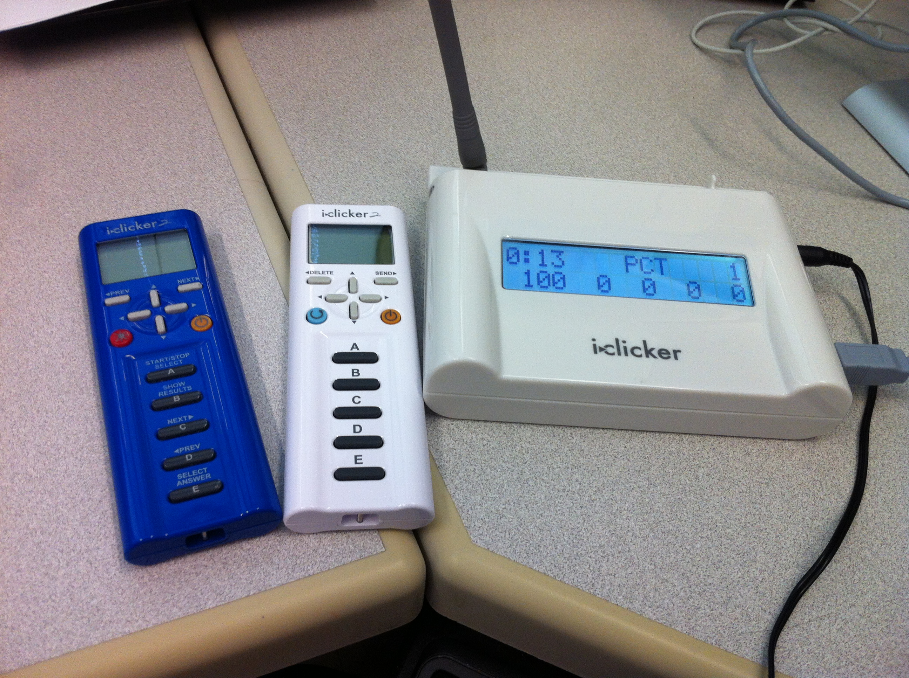
Why CRS ?
(Classroom Response Systems Clickers)
Technology for Classroom Assessment Techniques (Active Learning)
Shea, K. M. Beyond Clickers, Next Generation Classroom Response Systems for Organic Chemistry. J. Chem. Ed. 2016, 93, 971 - 974

Slide 5
Why CRS?
e.g. Ask a question based on material just covered in lecture
  Have all students answer
  Quickly check answers
  Correct misconceptions/misunderstanding
  Ease in grading classroom participation

Slide 6
What is your experience with clickers?
Have not tried them but am interested
Use them occasionally
Use them regularly
Have not tried them:
  wasn’t planning to do so or had not considered them yet
Opposed to their use

Slide 7
What are the pedagogical benefits of using clickers?
Improved engagement
Improved retention of material
Improved retention of students (course/institution)
Better attitudes concerning course and material
All of the above

Slide 8
What are the pedagogical benefits of using clickers?
Immediate feedback to student
Immediate feedback for instructor
All students respond
Anonymous to students
  Instructor can determine who answered and how
All of the above

Slide 9
Preparation for Course
ITS or instructor sets up software/hardware
Set up class with software
  Register students
    course management system or students individually
Add explanation of Classroom Assessment Techniques and specific clicker instructions to syllabus!

Slide 10
Preparation for Course/Class
Start with your current set of lecture notes
  Determine points where it would be good gauge understanding of a difficult topic
  Add to into notes
  Consider time “lost to lectures” by adding questions

Slide 11
Preparation for Course/Class
Integration with PowerPoint!
  Most systems “float above” Powerpoint presentation
  Back up questions otherwise

Slide 12
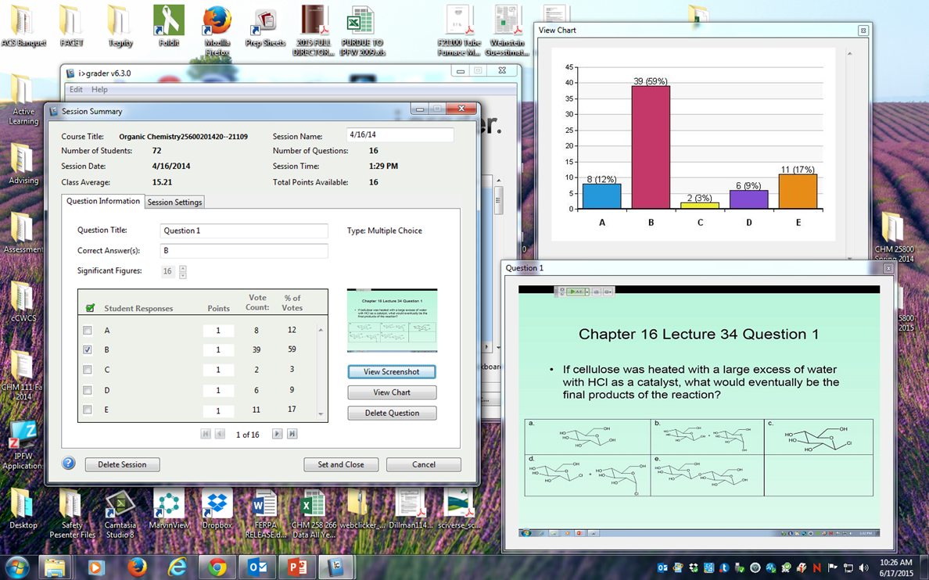
In Class/ After class
Start software: consider boot up time
Ask questions at appropriate points
  Follow student responses
Review student responses
Download into spreadsheet for grading

Slide 13
What barriers prevent you from adopting clickers?
Cost to student/department
Time to develop class materials
Time to learn new software
Loss of lecture time
Other

Slide 14
Types of Questions
Review gen chem or recent topics
Understanding of concept just covered
Assess retention of material
Application of concept
Inquiry/discovery-based learning

Slide 15
Question types
Multiple choice
Numerical
Text
Word Cloud
Highlight structure
Draw structure
Sources of questions
  Publisher generated
  Instructor generated
  Student generated

Slide 16
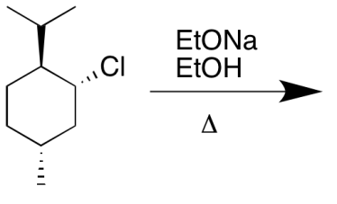
Where Did I Get All My Questions?
Most questions started with the usual sources
First modified for use with review session
Modified for use with clickers
What is the major product of the reaction shown?

Slide 17
Predict the Product, Multiple Choice
What is the major product of the reaction shown?

Slide 18
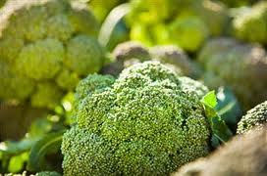
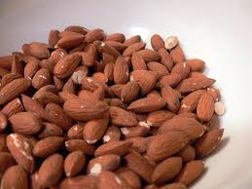
Stereochemistry, Numerical
How many stereogenic centers which are also asymmetric carbons are present in Riboflavin?

Slide 19
Conformations, Stability, etc., Text
Which of the following is the most stable conformation of cis-1-chloro-3-isopropylcyclohexane?

Slide 20
Alkene stability, Nomenclature, Text
What is the order of stability from most to least stable?
2-methyl-2-pentene
(Z)-hex-2-ene
2,3-dimethylbut-2-ene
Hex-1-ene
(E)-hex-2-ene

Slide 21
Mechanism, Numerical or Text
How should the mechanism arrows be written? (Enter a sequence of numbers.) The 1st number is the base of a curved arrow. The second number is the head. If there is a second arrow, the 3rd number would be the base and the 4th number would be the head.

Slide 22
Synthesis, Numerical or Text
Propose a multi-step synthesis to convert cyclohexene to ethoxycyclohexane.

Slide 24
Synethesis, Numerical
Synthesize 3-methylhex-3-ene from butan-2-ol and 1-bromopropane by entering the number for the correct reagents for the letters in the boxes. You will need to determine what Compounds U, V, and W along the way. Use each reagent only once.
1. (1. LiAlH₄, ether 2. H₃O⁺)
2. Na₂Cr₂O₇, H₂SO₄
3. Compound V
4. Compound W
5. Ph₃P
6. BuLi, ether
7. Mg, ether
8. NaOEt, EtOH

Slide 25
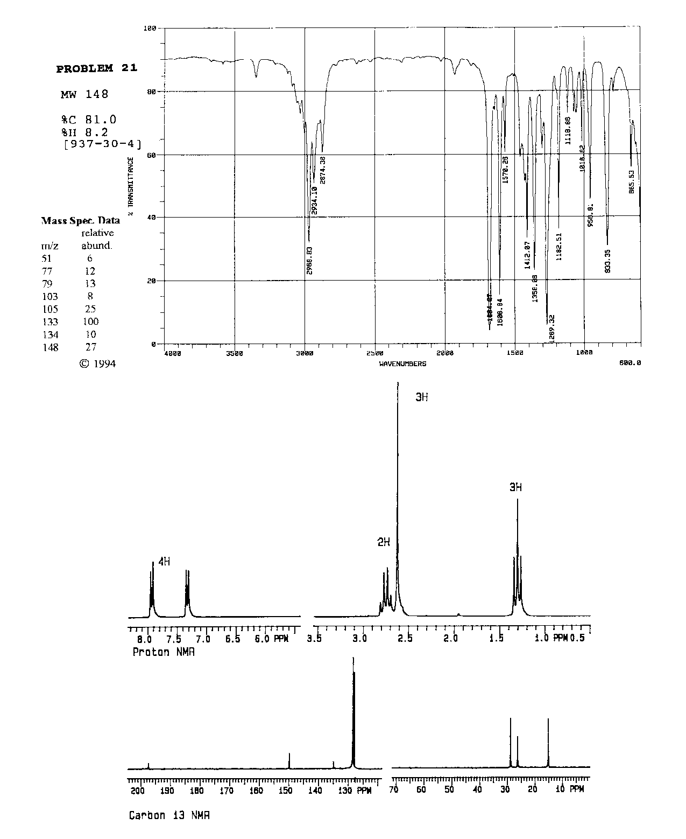
Spectroscopy,
Multiple Choice Student Generated

Slide 26
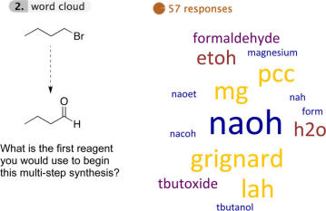
Word Cloud
Shea, K. M. Beyond Clickers, Next Generation Classroom Response Systems for Organic Chemistry. J. Chem. Ed. 2016, 93, 971 - 974

Slide 27
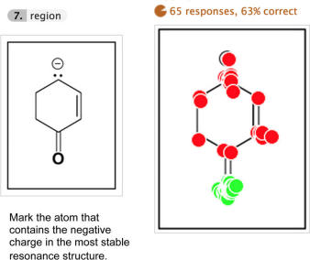
Highlight Structure
Shea, K. M. Beyond Clickers, Next Generation Classroom Response Systems for Organic Chemistry. J. Chem. Ed. 2016, 93, 971 - 974

Slide 28
Best Practices (Mazur)
Question posed
Students given time to think
Students record individual answers
Students convince neighbors (peer discussion)
Student record revised answers
Feedback to teacher: tally answers
Instructor’s explanation of correct answer
T. Vickrey, K. Rosploch, R. Rahmanian, M. Pilarz, M. Stains Research-Based Implementation of Peer Instruction: A Literature Review CBE Life Sci. Educ. 2015, 14, es3, 1.

Slide 29
Best Practices
Informal peer learning
  Students discuss questions
How much time for questions?
  Varies, ~2 min.
  Listen to level of conversation
What is the minimum number of questions suggested per 50 min. class period?
  Varies, ~3

Slide 30
Best Practices
Student “Buy In”
  Explain benefits of Classroom Assessment Techniques and use of CRS
  Use suggested minimum number during class
  Address incorrect answers and give immediate feedback
  Never just use for attendance

Slide 31
Best Practices
Three choices upon seeing overall student response
  Short explanation answer/choices
  Let students discuss, poll again
  Long explanation

Slide 32
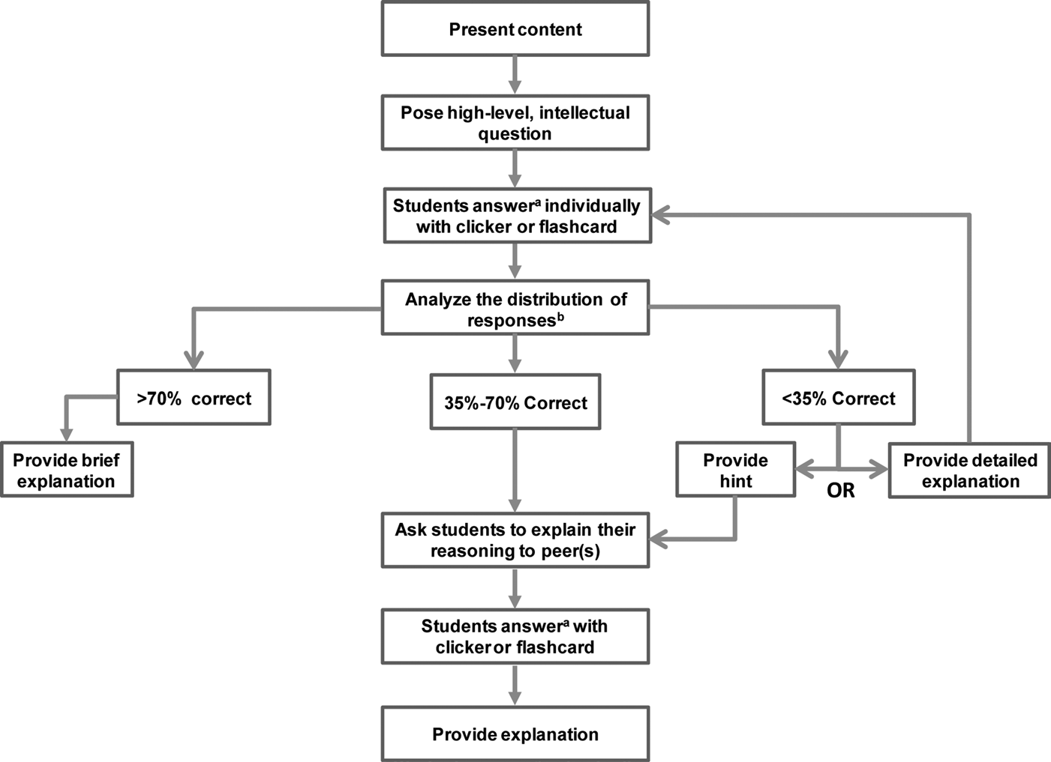

Slide 33
Predict the Product, Multiple Choice
What is the major product of the reaction shown?

Slide 34
Best Practices
Posting % responses
  Can affect follow up polling
Class participation points
  5 – 15%
    No grade for % correct
    Grade based on % correct
    Combination of both

Slide 35
Best Practices
  Missed Class
    e-mail reason for absence to avoid losing participation points
  Missing or dead device during class
    Write answers on a sheet of paper, sign and date

Slide 36
Potential Issues
Random guessing
  Check student data and contact students that seem to be guessing
Choosing same answer as smartest person nearby
  Go around room and ask individual students about their answers

Slide 37
Potential Issues
“Helping” absent friend
  How do you tell in a large class?
    Take a picture? (Warn students that you intend to do so.)
    If possible, count heads, compare to clicker response
    Short writing assignment that must be handed in at end of class individually
Exams and quizzes

Slide 38
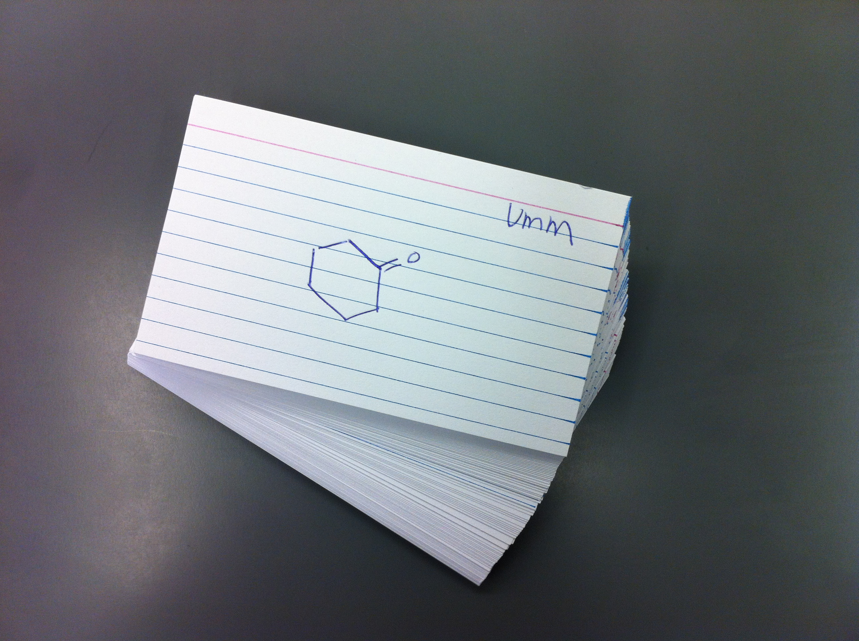
Do I have to use CRS?
Cards/sheets of paper
Index cards
Free, but harder to grade/quantify

Slide 39
Clicker References
Teaching with Classroom Response Systems by Derek Bruff, Jossey-Bass, 2009
Derek Bruff, Vanderbilt Center for Teaching, http://cft.vanderbilt.edu/guides-sub-pages/clickers/
Clickers in Action: Active Learning in Organic Chemistry by Suzanne M. Ruder, Norton, 2013

Slide 40
Classroom Assessment Technique References
  Thomas D’Angelo and K. Patricia Cross, Classroom Assessment Techniques: A Handbook for College Teachers, Jossey-Bass, 1993
  Bruff for clickers
  David C. Haak, et al. Increased Structure and Active Learning Reduce the Achievement Gap in Introductory Biology, Science 332, 1213 (2011)
  Louis Deslauriers, et al. Improved Learning in a Large- Enrollment Physics Class, Science, 332, 862, (2011)
  Linda B. Nilson, Teaching at Its Best, Jossey-Bass, 2010, pp. 273 – 280
  S. Freeman et al. Proceedings of the National Academy of Sciences, 111 (23), 8416 0 8415, 2014

Slide 41
Thanks!
Center for Enhancement of Learning and Teaching
  Gail Rathbun
  Ludwika Goodson
  Stephanie Stephenson
ITS
  Kathie Surface

Slide 42
System Options
Original Conventional Wisdom
  Use one system across your institution
    Decided by faculty and/ITS
  Advantages
    Potentially cheap for students
    Only one system for students
    Support for faculty
Other faculty go it alone

Slide 43
Implementation Options
Options for student use
  Own
  Share
  Rent
  Mobile device
  Provided by department

Slide 44
System Options
Important considerations
  Cost
  Ease of us
    Software
    Hardware
  Software/Hardware
    Robust and reliable
  Reviewing responses
  Capabilities/Options
  Where does data reside?

Slide 45
Dealing with “Lost” Lecture Time
Prune your lectures
  Maybe some portions are not essential
Turn examples into questions
Convert the simplest and driest topics into online videos to be watched outside of class

Slide 46
