Slide 1
Clickers in Organic Chemistry
Vincent Maloney
Indiana U. Purdue U. Fort Wayne
Active Learning in Organic Chemistry Workshop

Slide 2
What is your experience with clickers?
Have not tried them but am interested
Use them occasionally
Use them regularly
Have not tried them but am unconvinced
Opposed to their use

Slide 3
What barriers prevent you from adopting clickers?
Cost to student
Cost to department
Time to learn new software or adding questions
Loss of class time
Other
Clicker user/no barriers

Slide 4
Resources
Teaching with Classroom Response Systems by Derek Bruff, Jossey-Bass, 2009
Clickers in Action: Active Learning in Organic Chemistry by Suzanne M. Ruder, Norton, 2013
  Suggested by J. Muzyka

Slide 5
Why Clickers ?
(Student Response Systems)
Technology for Classroom Assessment Techniques (CATs)
Variety of methods for obtaining immediate feedback of student knowledge and learning
  before any quiz or exam where it’s “too late”

Slide 6
Why Clickers ?
e.g. Ask a question based on material just covered in lecture
  Have all students answer
  Quickly check answers
  Correct misconceptions/misunderstanding

Slide 7
Benefits
Immediate feedback
All students respond
Anonymous to students
  Instructor can determine who answered and how
Improve student learning
Grading?

Slide 8
Benefits
Improve student learning
  Thomas D’Angelo and K. Patricia Cross, Classroom Assessment Techniques: A Handbook for College Teachers, Jossey-Bass, 1993
  Bruff for clickers
  David C. Haak, et al. Increased Structure and Active Learning Reduce the Achievement Gap in Introductory Biology, Science 332, 1213 (2011)
  Louis Deslauriers, et al. Improved Learning in a Large- Enrollment Physics Class, Science, 332, 862, (2011)
  Linda B. Nilson, Teaching at Its Best, Jossey-Bass, 2010, pp. 273 – 280
Notes:
Here are some useful references

Slide 9
What are the pedagogical benefits of using clickers?
Improved engagement
Improved retention of material
Improved retention of students (course/institution)
Better attitudes concerning course and material
All of the above

Slide 10
Types of question
Review gen chem
Assess retention of material
Application of concept
Inquiry/discovery-based learning
Check attendance?

Slide 11
Solving problems
Multi-step synthesis
Mechanisms
Spectral interpretation

Slide 12
Question types
Multiple choice
Numerical
Text
Sources of questions
  Instructor generated
  Publisher generated
  Student generated

Slide 13
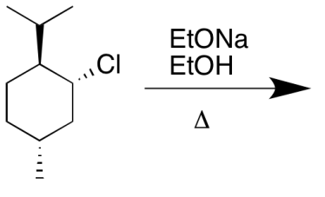
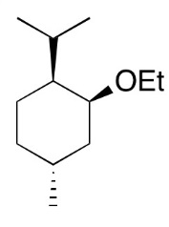
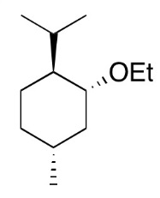
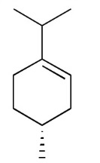
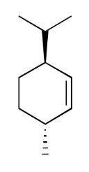
What is the major product of the reaction shown?
A
B
C
D

Slide 15
How many signals appear in the ¹³C NMR spectrum of the compound shown?
Rank | Responses
1 | 5
2 | 4
3
4
5
6 | Other
Values:
Value Matches: 0

Slide 17
What kind of isomers are these?
Rank | Responses
1 | DIASTEREOMERS
2 | DIASTEREOMER
3 | DIASTEROMER
4 | STEREOISOMERS
5 | CONFIGURATIO...
6 | Other
Values:
Value Matches: 0

Slide 19
How should the mechanism arrows be written? (Write a sequence of numbers. The 1st number is the base of a curved arrow. The second number is the head. If there is a second arrow, the 3rd number would be the base and the 4th number would be the head.
Rank | Responses
1 | 3678
2 | 36
3
4
5
6 | Other
Values:
Value Matches: 0

Slide 21
Propose a multi-step synthesis to convert cyclohexene to ethoxycyclohexane.
Rank | Responses
1 | 111213
2 | 810
3
4
5
6 | Other
Values:
Value Matches: 0

Slide 23
Synthesize 3-methylhex-3-ene from butan-2-ol and 1-bromopropane by entering the number for the correct reagents for the letters in the boxes. You will need to determine what Compounds U, V, and W along the way. Use each reagent only once.
1. (1. LiAlH₄, ether 2. H₃O⁺)
2. Na₂Cr₂O₇, H₂SO₄
3. Compound V
4. Compound W
5. Ph₃P
6. BuLi, ether
7. Mg, ether
8. NaOEt, EtOH

Slide 24
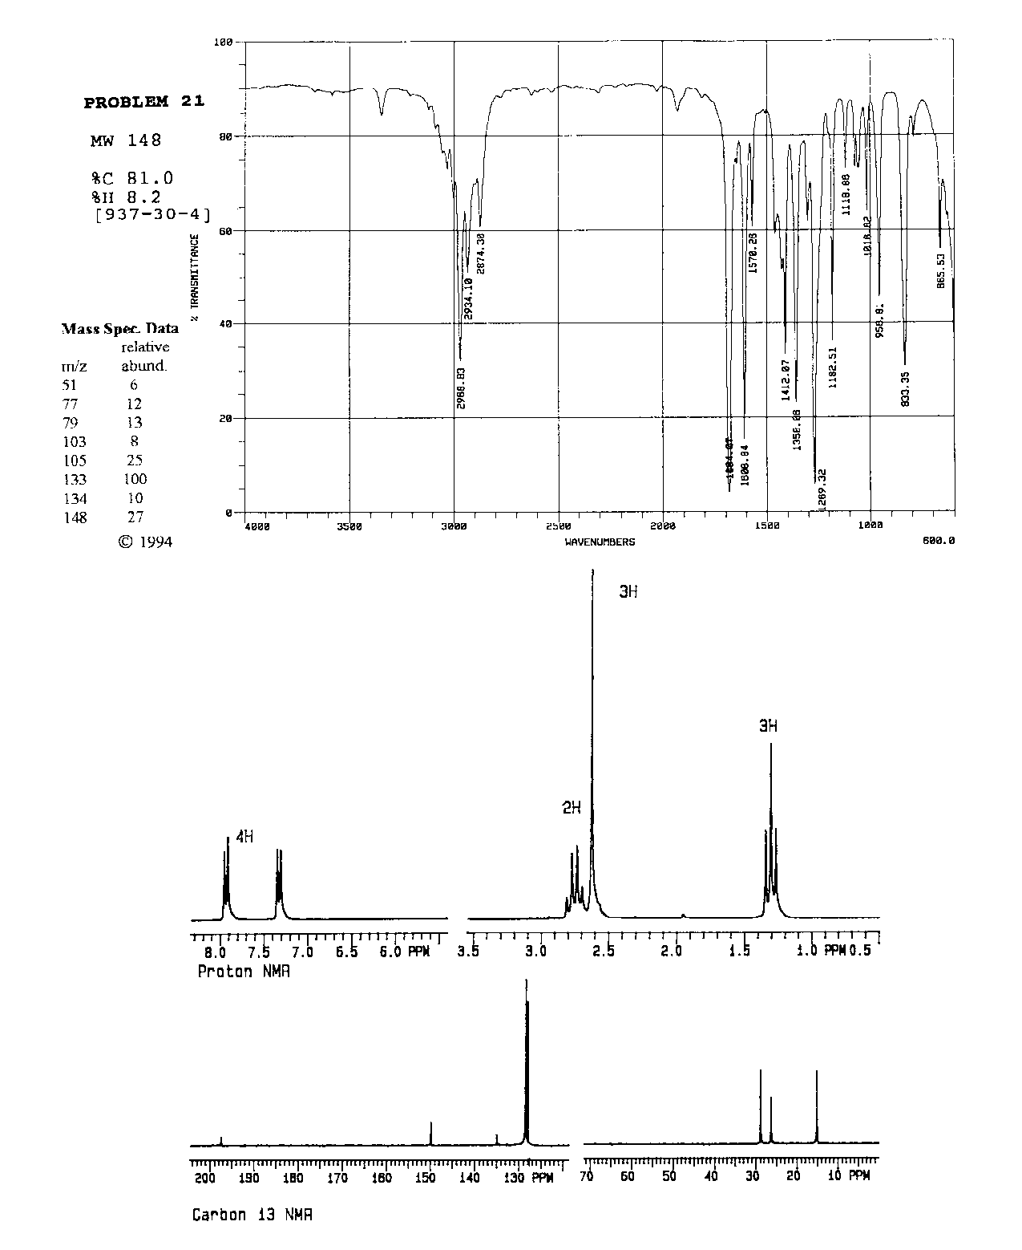

Slide 25
Practices
Informal peer learning
  Students discuss questions
How time for questions?
  Varies, ~ 2 min.
  Listen to level of conversation
What is the minimum number of questions suggested per 50 min. class period?
  Varies, ~ 3
Notes:
I often have only two questions per class period. But each question is asked twice, with student discussion on the second polling. I don’t know if that’s how you do it. I figure it’s useful to point out different approaches.

Slide 26
Practices
“Good” questions for peer learning
  < 70% correct but >30% correct
  Ask students to discuss with someone who disagrees and poll again
Easy questions (>80% correct) often given to avoid discouragement
Posting % responses
  Can affect follow up polling
Notes:
Okay, it’s clear that you’re reading the same literature I am, because you’re doing the peer learning approach the same way I do.

Slide 27
Practices
Class participation points
  e-mail reason for absence to avoid losing clicker points
  No grade for % correct
  Grade based on % correct
  Combination of both

Slide 28
Potential Issues
Choosing same answer as smartest person nearby
Random guessing
“Helping” absent friend
Exams and quizzes

Slide 29
Logistics
Options for student use
  Own
  Share
  Rent
  Mobile device
Integration with PowerPoint

Slide 30
Original Conventional Wisdom
Use one system across your institution
  Decided by faculty and/ITS
Mobile devices
  Hardware no longer consideration
  Important considerations
    Cost
    Software
    Ease of use
    Where does data reside

Slide 31
Drawing Structures
Mastering Chemistry: Pearson
  Easier to check student responses in class
  Draw structures and vote on them

Slide 32
Acknowledgements
IPFW
  CELT
  ITS
Jennifer Muzyka and Centre College

