Slide 1
Transformation of the Traditional Organic Chemistry Lecture Sequence into a Hybrid of Face to Face Peer Learning and Online Lecture
Vincent Maloney

Slide 2
Introduction
Outline
  Journey to “flipping” the course i.e. Why?
  Previous course structure
  Flipped course structure
  Student survey
  Assessment and Conclusions
  Observations
    What was the same and what was different?
  Final Conclusions

Slide 3
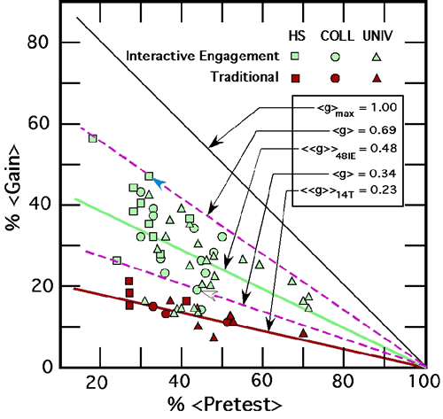
Why Change Everything?
CELT Fall Teaching Conference 2007, Todd Zakrajsek
Hake, R. R. American Journal Physics, 66, 1998, 64-74
If this is true, should I still be lecturing?

Slide 4
L. Nilson, Teaching at Its Best
Bloom’s Taxonomy
  Knowledge
  Comprehension
  Application
  Analysis
  Synthesis
  Evaluation
How many of these outcomes do you think traditional lecture addresses?
    a. 0 b. 1 c. 2 d. 4 e. 6

Slide 5
Bloom’s Taxonomy
How many of these outcomes do you think traditional lecture addresses?
    0 b. 1 c. 2 d. 4 e. 6
    According to L. Nilson, Teaching at Its Best p. 107
    Knowledge Transfer
    CAT’s, JiTT, Peer to peer problem solving, POGIL address more learning outcomes, all remaining
    If this is true, should I still be lecturing?

Slide 6
Some Further References
Smith, K. A., Sheppard, S. R., Johnson, D. W., Johnson, R.T Journal of Engineering Education, 94, No. 1 2005, 87-101.
Nelson, C. E. Want Brighter, Harder Working Students? Change Pedagogies! Cooperative Learning in Higher Education, 2010, 119-140.
Nelson, C. E. in Evolution Challenges: Integrating Research and practice in Teaching and Learning about Evolution Rosengren, K. S.; Brem, S.; Evans, E. M.; Sinatra, G. M. Oxford Scholarship Online, 2012 DOI:10.1093/acprof:oso/9780199730421.001.0001

Slide 7
MOOCs
Massive Open Online Courses
  Disruption of higher education
  “World famous” professor from elite institution provides recorded lectures, courses materials, and assessment software (online quizzes, exams, etc.)
  Students answer each others questions through crowdsourcing, meet ups, etc.
  Claim: courses taught better at a fraction of the cost
  Have moved past “hype” and even “backlash” phase
  Can university professors be replaced? Should courses be taught a different way?

Slide 8
Recorded Lectures
Around for a long time
  What’s different
Much easier to access and watch anywhere
Maybe courses should be done differently

Slide 9
Other Benefits
Retention
  In specific class
  At univeristy
Graduation rates
Interactive learning
  Interactions that build relationships
    Students and professors
    Others students

Slide 10
References
Smith, K. A., Sheppard, S. R., Johnson, D. W., Johnson, R.T Journal of Engineering Education, 94, No. 1 2005, 87-101.
Chamblis, D. F., Takacs, C. G. How College Works, Harvard University Press, Cambridge, MA, 2014.

Slide 11
Traditional Lecture: Straw Man
  Students read text before lecture (maybe)
  Lecture given in traditional manner
  After class, students work on assignments
    May work together
    May ask instructor questions
  Problems in understanding not recognized until homework turned in or quiz/exam

Slide 12
Organic Chemistry IPFW
Traditional lecture plus
    Clickers questions
      ~ 3 per class with peer to peer problem solving
      Review sessions
        2x per week
        Peer to peer problem solving
        ~40% of class attended
        Arrangements for those who could not attend
    Lectures recorded on Tegrity for subsequent viewing
Courses partially flipped

Slide 13
Flipping IPFW Organic Chemistry
Record lectures < 20 min.
    Lecture length based on topic
      1.5 – 20 min.
    Chunking (Nilson)
    295 lectures recorded year
      130 fall semester
        ≈17 h, ≈ 20.5 classes!
      165 spring semester
        ≈17 h, ≈20.5 classes!
  Students watch lectures before class

Slide 14
Flipping IPFW Organic Chemistry
  Students watch lectures before class
  Students complete online homework assignment in Blackboard
    162 questions in fall
    98 questions in spring

Slide 15
Flipping IPFW Organic Chemistry
  Face to Face Class
    Nearly entire class devoted to peer to peer problem solving
      98 students fall semester
      88 students spring semester
    Ask questions of increasing complexity, scaffolding
    10 – 12 questions per class
  End of Week: attempted Muddiest Point CAT

Slide 16
Flipping IPFW Organic Chemistry
Review session and some traditional homework from text now in class
  Everyone benefits from “review sessions”
Should be time neutral for student
Exam/quiz schedule kept the same

Slide 17
Summary of Results
Good news
  Students like it
Bad news
  No improvement in grades
Did no harm!
  1st attempt
  Foundation from which to improve

Slide 18
Student Survey
Given last week both semesters
IRB approval pending
22 questions
  Likert Scale
  1 strongly disagree to 5 strongly agree

Slide 19
Student Survey
I prefer watching the online lectures because it allows more time to work on difficult problems and concepts in class.
I believe that I learned material better with the current format than I would have if the course had been presented in the traditional format.

Slide 20
Student Survey
I understand the material better when I can work on problems with other students during class.
I got to know more classmates in this class than I would have in a traditional format.
The current format should be continued for organic chemistry.

Slide 21
Conclusions
Solid majority believes they are learning material better
Larger majority wanted to continue this method for 2nd semester
If meeting and building relationships helps with retention and obtaining a degree, then there is evidence that “flipping the classroom” does that.

Slide 22
Assessment and Grades
Assessment
  Pre- and post-test scores not available
  Compared grades to 2011-2012 and 2012-2013 organic classes.
    Obviously limited, many variables, exams and quizzes not the same
    Perhaps broad changes can be observed
    Data complicated by drop/make-up policy and changes to accommodate flip
  End of spring semester: National ACS 2004 Organic Chemistry Exam

Slide 23
Assessment and Grades
Grading Fall
Year | Quizzes | Nomenclature Quiz | Exams | Final Exam | Clicker | Homework | Total
2013 | 100 | 0 | 200 | 150 | 50 | 50 | 550
2012 | 100 | 25 | 200 | 150 | 25 | 50 | 550
2011 | 100 | 25 | 200 | 150 | 25 | 50 | 550

Slide 24
Assessment and Grades
Grading Spring
Year | Quizzes | Nomenclature Quiz | Exams | Final Exam | Clicker | Homework | Total
2014 | 100 | 0 | 200 | 200 | 50 | 50 | 600
2013 | 100 | 25 | 200 | 200 | 25 | 50 | 600
2012 | 100 | 25 | 200 | 200 | 25 | 50 | 600

Slide 25
Assessment and Grades Overall Results
Over the entire, year the performance of the “flipped class” was comparable to the previous two “traditional” classes including the ACS exam
Lower withdrawal rate in fall may indicate flipped classes may favor persistence, but not observed in spring
Whatever effects the course flip had, they are small in comparison to other factors leading to variability in scores.

Slide 26
Observations
Flipped classrooms are not a cure all
  Definitely agree
Much time investment required up-front but more efficient over time.
  Agree, but manageable
  Maybe best to evolve course so that flip doesn’t occur all at once
Will take a few iterations to get it right
  Certainly hope that’s true!

Slide 27
Observations
Students may resist flipped learning.
  Some uncertainty at first but very little pushback
    Two “proxies” did express concerns but otherwise no problems
    Some thought quizzes and exams were harder than previous years

Slide 28
Observations
Never call your class: a flipped classroom or experiment
  Very careful to avoid these terms
  Explained in syllabus and class that evidence in literature has shown that this works better
  Explained I was early adopter and not innovator
  May explain low amount of pushback

Slide 29
Observations
Make sure assessment cover out of class assignments
  Definitely agree
Very little review before questions
  Students preferred to work on questions and see explanations
Despite 295 video lectures available, students will still use other sources despite whether correct or not

Slide 30
Observations
Similar positive student comments
Why only 17 h of lecture per semester?!?!
  After removing
    Starting and ending class comments/announcements
    Review
    Responses to questions asked by students in class
    Most classroom assessment techniques and clicker questions, that’s all that was left
Classroom assessment techniques and flipping the class does not involve sacrificing content.

Slide 31
Observations
Increased rigor
  More synthesis problems
  Better “lecture descriptions”
More interactions with students after class
  Suggested ways to improve online lectures
More flexibility in pacing material
Increased use of websites, software, and videos
More engagement with material than in years past
Notes:
Outline of Talk
Straw Man: Traditional Lecture
Learning Outcomes
What different techniques address
The Flip
My “Small” flip
My upcoming “Big Flip”
Evolve
Lecture Capture Technology
Initial use
Capabilities
Course Flip Use
Vendors
Workshop Flip
organicERs website
small group discussion of each question
report out
Last Comments and Acknowledgments

Slide 32
Observations
Muddiest Point CAT
  Ask students to write one or two points that they found most difficult to understand on a sheet of paper and hand in at end of class
  Early on much agreement on most difficult topics which lead to 3 new videos
  Only a handful of responses per topic
Notes:
Outline of Talk
Straw Man: Traditional Lecture
Learning Outcomes
What different techniques address
The Flip
My “Small” flip
My upcoming “Big Flip”
Evolve
Lecture Capture Technology
Initial use
Capabilities
Course Flip Use
Vendors
Workshop Flip
organicERs website
small group discussion of each question
report out
Last Comments and Acknowledgments

Slide 33
Observations
OK, but why aren’t grades better?
Notes:
Outline of Talk
Straw Man: Traditional Lecture
Learning Outcomes
What different techniques address
The Flip
My “Small” flip
My upcoming “Big Flip”
Evolve
Lecture Capture Technology
Initial use
Capabilities
Course Flip Use
Vendors
Workshop Flip
organicERs website
small group discussion of each question
report out
Last Comments and Acknowledgments

Slide 34
Observations
Room for improvement
  Need to improve “getting out to students”
    Ask at least 1 question per class where students write answers
  Start with higher difficulty level for questions
  Change pacing and distribution of questions
  More structure to order and choice of questions
  Scaffolding!
    Build up student mastery through a series of questions

Slide 35
NMR
¹H NMR allows following information to be determined about a molecule
what types of H atoms (protons) are present
e.g. -CH₂-CH₃
-CH₂-O
-CH₂-Cl
# of H atoms (protons) that are present
# of H atoms nearby to absorbing protons (spin splitting)

Slide 36
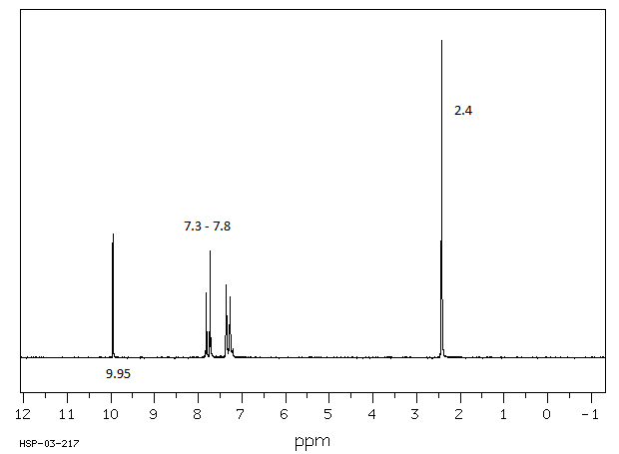
Chapter 15 Lecture 28 Questions 2 + 3
The peak at 9.95 ppm is the absorption for which proton?
2.4 ppm?

Slide 37
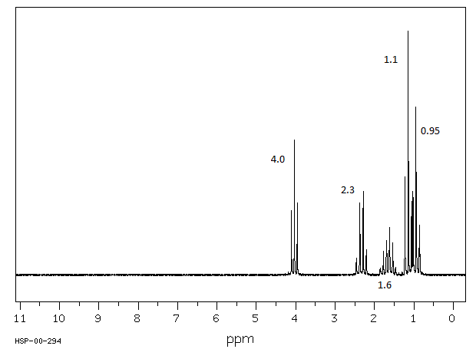
Chapter 15 Lecture 28 Questions 4,5,6,7

Slide 38
Chapter 15 Lecture 28 Question 8
Structure?

Slide 39
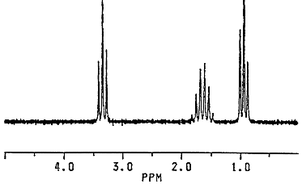
Question 9 The molecular formula for this compound is C₆H₁₄O. What is the structure of the compound?

Slide 40
Chapter 15 Lecture 28 Question 10
Which two elements cause protons to have broad peaks in ¹H NMR unless the are no acid or base impurities and the compound is dilute?

Slide 41
Chapter 15 Lecture 28 Question 11
Which structure tends to appear as 2 doublets in ¹HNMR?

Slide 42
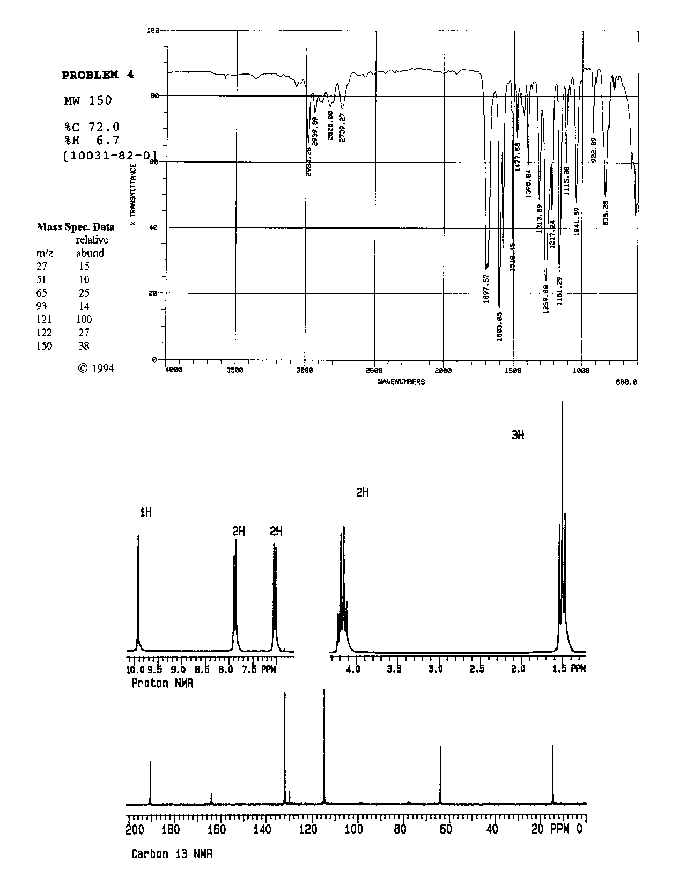

Slide 43
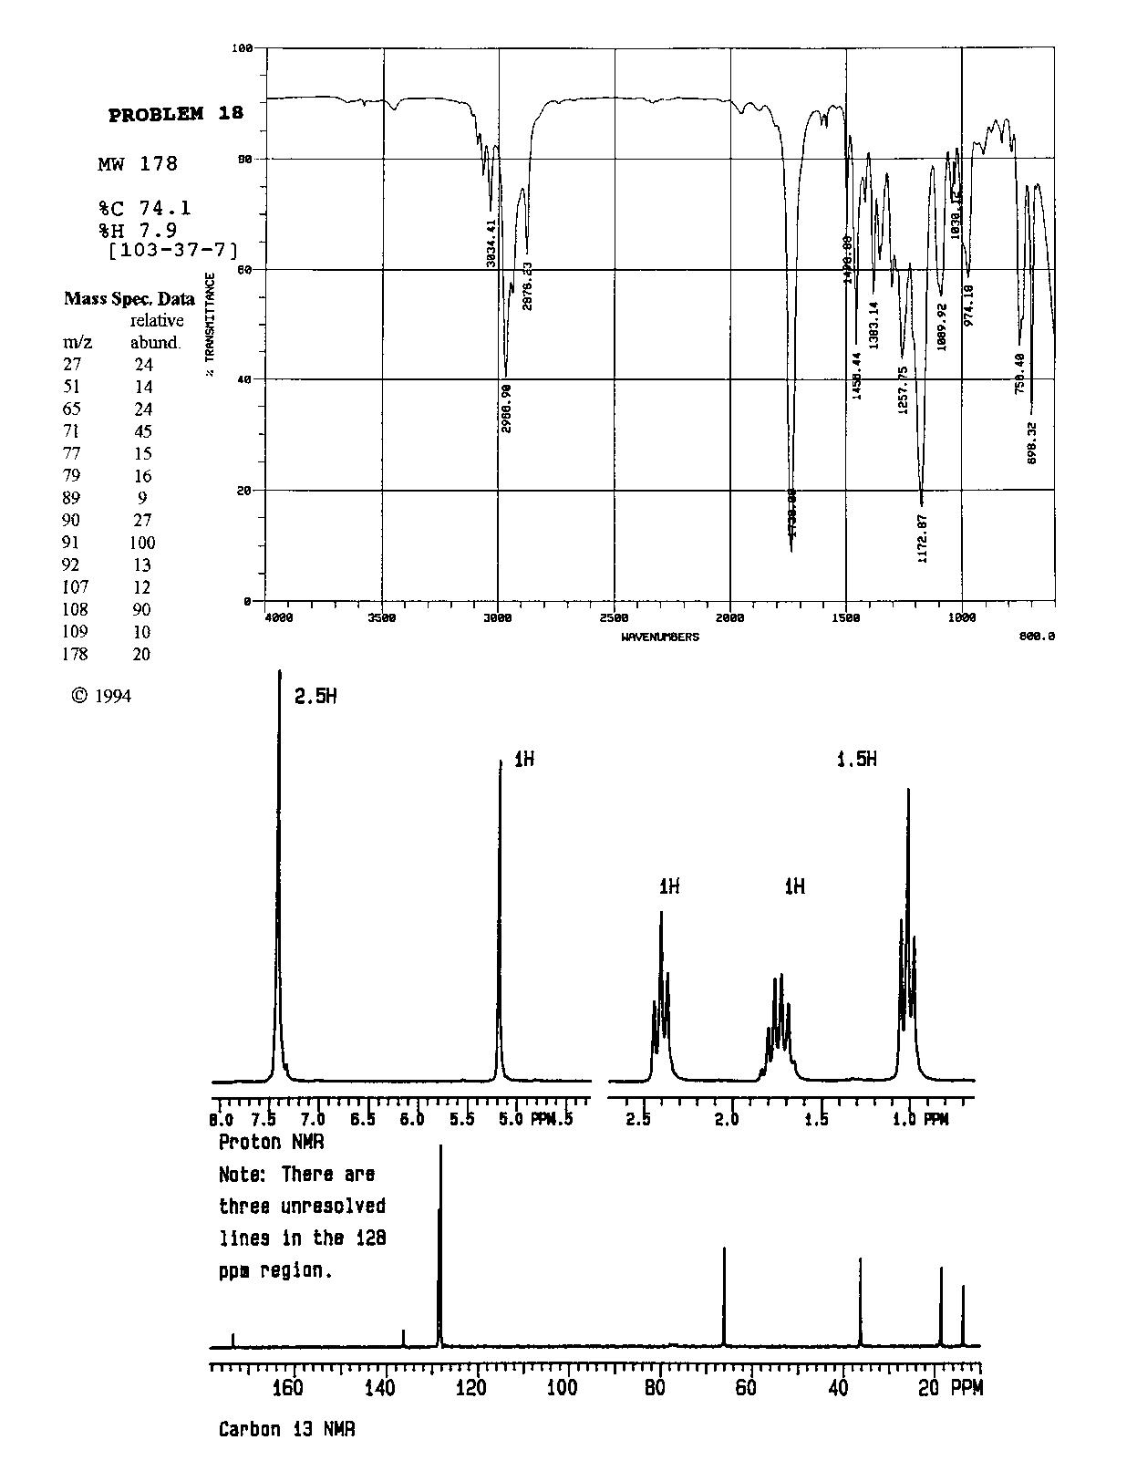

Slide 44
Observations
Negligible difference in grades and leanring may be due to large amount of flipped classroom already present in “traditional” lecture.

Slide 45
Conclusions
Majority of students prefer flipped class
Student did meet more fellow students
  Effect on retention and graduation?
Comparable grades
“Flip” did no harm, students like it, and room to improve learning!

Slide 46
Thanks!
Center for Enhancement of Learning and Teaching
  Gail Rathbun
  Ludwika Goodson
  Stephanie Stephenson
ITS
  Mike Phillips

