Slide 1
Screen Capture Technology
Bob Rossi
ALOC Workshop – Cincinnati, OH
June 20 – 23, 2016

Slide 2
How I “Flipped” My Organic Classes
Technology Used
Created “Khan Academy” style videos
Student sees a “blackboard” background with colored “chalk” writing
Hear only the instructors voice
Less distractions for viewer – focus on content
Videos can readily and cost-effectively be self-prepared using a PC with some additional, inexpensive hardware and software

Slide 3
How I “Flipped” My Organic Classes
Technology Used
Screen Capture Software
Snagit (TechSmith)
Camtasia (TechSmith)
Jing (freeware, http://www.techsmith.com/jing.html)
FrontCam (freeware, http://frontcam.com/)
Digital Free-Hand Drawing Software
SmoothDraw (freeware, http://www.smoothdraw.com/product/)
MSWord and PowerPoint
USB tablet with stylus or touch-screen computer
Bamboo model CTH-470 (Wacom)
Intuos Draw model number CTL490D (Wacom)

Slide 4
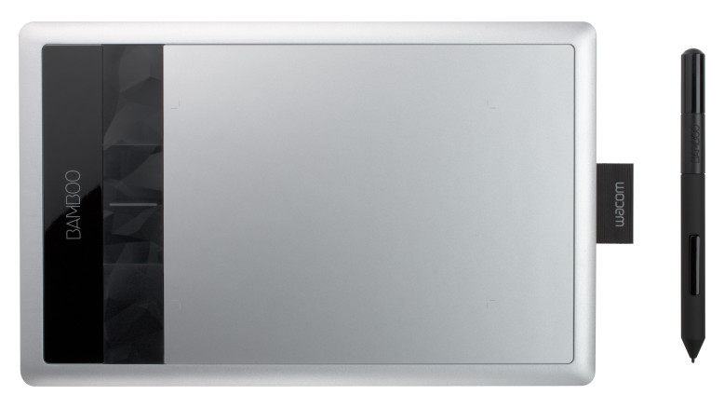
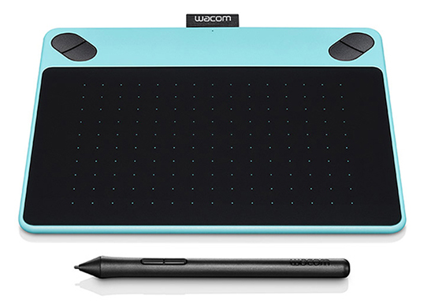
Wacom Tablets
Bamboo model CTH-470
Intuos Draw model CTL490D

Slide 5
Example – Introduction to Diastereomers (10:49)

