Slide 1

Screen Capture Technology
Bob Rossi
ALOC Workshop – Washington, D.C.
June 22 – 25, 2015

Slide 2

How I “Flipped” My Organic Classes
Technology Used
  Created “Khan Academy” style videos
    Student sees a “blackboard” background with colored “chalk” writing
    Hear only the instructors voice
      Less distractions for viewer – focus on content
    Videos can readily and cost-effectively be self-prepared using a PC with some additional, inexpensive hardware and software

Slide 3
How I “Flipped” My Organic Classes
Technology Used
  Screen Capture Software
    Snagit (TechSmith)
    Camtasia (TechSmith)
    Jing (freeware, http://www.techsmith.com/jing.html)
    FrontCam (freeware, http://frontcam.com/)
  Digital Free-Hand Drawing Software
    SmoothDraw (freeware, http://www.smoothdraw.com/product/)
    MSWord and PowerPoint
  USB tablet with stylus or touch-screen computer
    Bamboo model CTH-470 (Wacom)

Slide 4
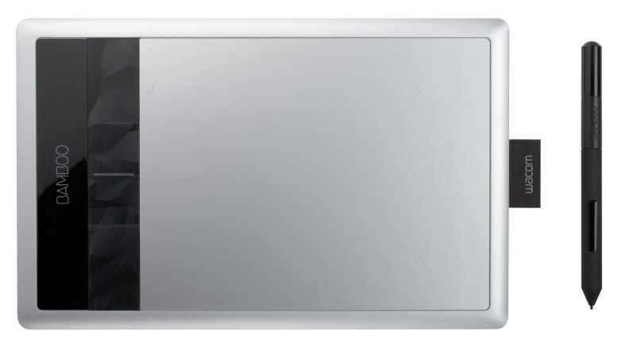
Bamboo Model CTH-470 (Wacom)

Slide 5
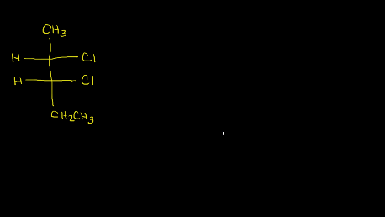
Example – Introduction to Diastereomers (10:49)

