Slide 1
Livescribe pens
A Short Description of How to Use Livescribe Pens
Cathy Welder, Dartmouth College
cCWCS – Active Learning in Organic Chemistry
Cincinnati June 21, 2016

Slide 2
What Are Livescribe Pens and What Can You Do with Them?
Livescribe Echo pens have a built-in camera and microphone. The pen can record writing on special paper and audio. Resulting pencast can be shared.
Livescribe 3 uses mic and memory of tablet and displays written material on screen of Android or iOS devices as you write.
Notes:
Record audio only. Record writing only. Record both audio and writing. Record audio then add written material during playback. Livescribe 3 doesn’t have built in memory or microphone.

Slide 3
How do we use the pens at Dartmouth?
Lecture Material
Flipped classroom
Remedial or tutorial topics
Answer Keys
Quizzes
Exams
Problem sets
Data Sharing and Electronic Notebooks in Teaching Labs
Research Notebooks

Slide 4
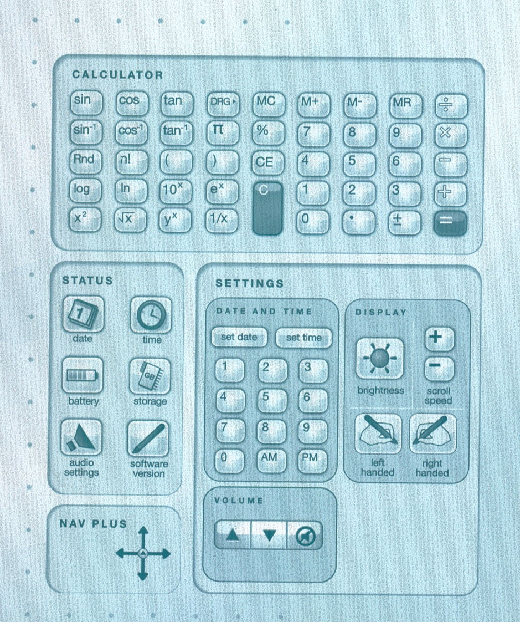
Introduction to the Pen

Slide 5
Introduction to the Pen
Controls are found at the bottom of each page.
Demonstration
Record
Transfer to computer (Use Echo Desktop.)
Create pencast (Select pages and Share.)
Play in browser

Slide 6
Costs (Livescribe.com)
Item | Cost
Echo Pen | $130 (2 GB)
Livescribe 3 | $150
Ink Cartridges | 5 for $7
Headset | $20
3-subject notebook (150 sheets) | $9
(Save $20 with referral.)

Slide 7
Helpful Hints
Be careful not to cover camera with finger when writing.
Write before you speak.
Bookmarks put a star on top of the last thing you wrote, partially covering it.
3-D Recording Premium Headset ($20) records better sound for Echo pens.

Slide 8
Other Information
1 GB gives ~ 100 hours of recording time.
Permanently remove data from the pen by archiving the notebook.

Slide 9
Pros
Notes are converted to a digital format.
Text is searchable, even with poor handwriting!
Pencasts can be sent to Evernote, Facebook, OneNote, mobile devices, and your computer.
Echo pens work with PC or Mac. Livescribe 3 works with Apple or Android devices.
Livescribe 3 uses microphone and storage capacity of iOS or Android devices
Comes with 500 MB free online storage.

Slide 10
Cons
Pen is somewhat bulky/heavy.
You cannot write in color.
Ink cartridges are small. (5 refills for $7)
You cannot edit. (You can pause.)
Difficult to print “printable notepads.” (Use the Postscript driver!)
Read app reviews before purchasing.

