Slide 1
Livescribe pens
A Short Description of How to Use Livescribe Pens
Cathy Welder, Dartmouth College
cCWCS – Active Learning in Organic Chemistry
Atlanta, June 13, 2017
Notes:
I cannot use Doceri for this presentation as I need an internet connection to play the file back.

Slide 2
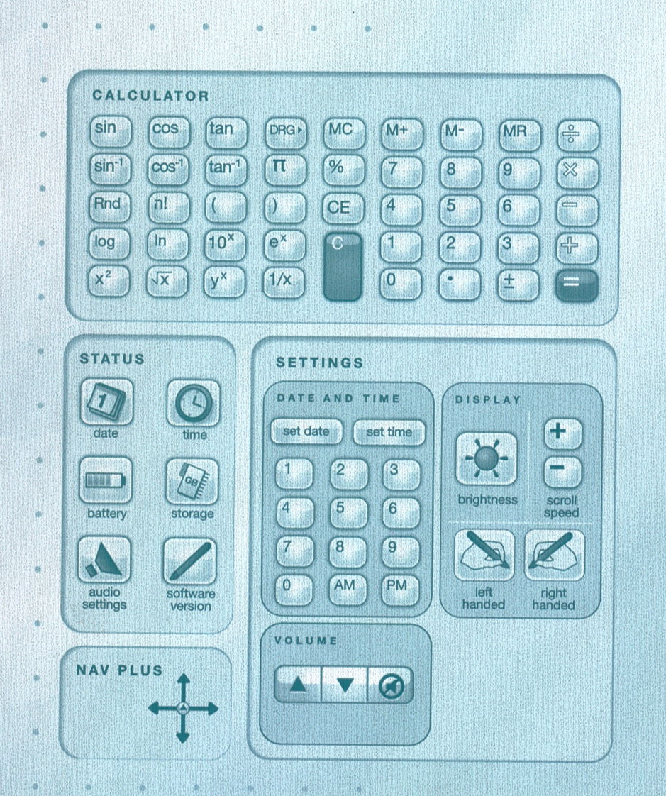
Introduction to the Pen

Slide 3
Introduction to the Pen
Controls are found at the bottom of each page.
Demonstration
Record
Transfer to computer (Use Echo Desktop.)
Create pencast (Select pages and Share.)
Play in browser

Slide 4
Helpful Hints
Be careful not to cover camera with finger when writing.
Write before you speak.
Bookmarks put a star on top of the last thing you wrote, partially covering it.
3-D Recording Premium Headset ($20) records better sound for Echo pens. (Headset for your phone will likely work, too.)

Slide 5
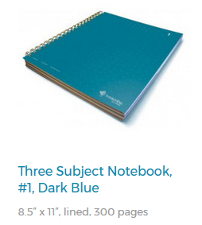
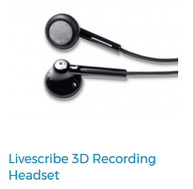
Costs (Livescribe.com)
Item | Cost
Echo (2 GB) or Livescribe 3 Pen | $180
Ink Cartridges | 5 for $7 (Echo) 8 for $10 (3)
Headset | $20
3-subject notebook (150 sheets) | $9
Notes:
If you have earbuds for your phone, they may work with the Echo pen.

Slide 6
Other Information
1 GB gives ~ 100 hours of recording time.
Permanently remove data from the pen by archiving the notebook.

Slide 7
Pros
Notes are converted to a digital format.
Text is searchable, even with poor handwriting!
Pencasts can be sent to Evernote, Facebook, OneNote, mobile devices, and your computer.
Echo pens work with PC or Mac. Livescribe 3 works with Apple or Android devices.

Slide 8
Cons
Pen is somewhat bulky/heavy.
You cannot write in color.
Ink cartridges are small.
You cannot edit. (Maybe a pro. You can pause.)
Difficult to print “printable notepads.” (Use the Postscript driver!)
Only one pencast per page.
Read app reviews before purchasing.
Notes:
I would be happy to send you pdf files of the printable notebooks if you have trouble.

