Slide 1
Just-in-Time Teaching Learning Objectives and Reading Prompts
Jennifer Muzyka, Centre College
Justin Houseknecht, Wittenberg University

Slide 2
Outline
Discuss JiTT prompt answers
Students work in groups
Review group solutions

Slide 3
Central Premise
Most students need assistance to read effectively.

Slide 4
Two Similar Methods
Reading Prompts
Learning Objectives
Three questions
Focus students’ attention
Last question about student confusion
Detailed (1/2 page)
Organization
Study guide
In conjunction with online homework and question about student confusion

Slide 5
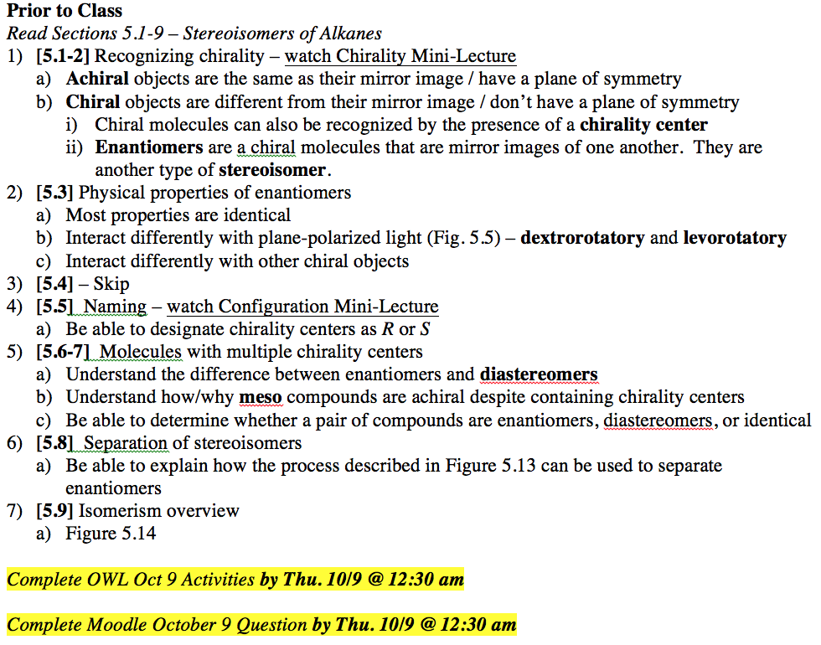
Two Similar Methods
Reading Prompts
Learning Objectives
Read sections 5.1 through 5.4 in your textbook.
What does it mean about a sample when it is described as optically active? Your answer should describe how optical activity is determined experimentally as well as structural features of the compound(s) in the sample.
Describe briefly how Pasteur separated the two kinds of tartaric acid salts. Describe his observations about the original sample as well as the two separated samples.
Using the structure editor, draw a compound that is chiral. Make sure that you show stereochemistry in your drawing.
What did you find most confusing in today’s reading? If you understood all of today’s reading, what did you find most interesting in the reading?
Notes:
I’m not sure how effective this slide will be, since the text is too small for audience members to read.

Slide 6
Write a learning objective and reading prompt, discuss with neighbor
19.1 Naming Aldehydes and Ketones
19.2 Preparing Aldehydes and Ketones
19.3 Oxidation of Aldehydes and Ketones
19.4 Nucleophilic Addition Reactions
19.5 Nucleophilic Addition of H₂O
19.6 Nucleophilic Addition of HCN
19.7 Irreversible Addition Reactions
19.8 Nucleophilic Addition of Amines
19.9 Wolff-Kishner Reduction
19.10 Nucleophilic Addition of Alcohols
19.11 The Wittig Reaction
19.12 Biological Reductions
19.13 Addition to α,β-Unsaturated Systems
19.14 Spectroscopy

