Slide 1
Just-In-Time Teaching at Wittenberg University
Active Learning in Organic Chemistry
Cincinnati, Ohio.
June 22, 2016
Justin Houseknecht, PhD

Slide 2
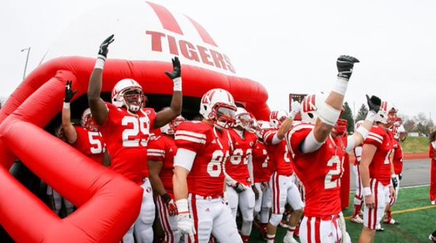
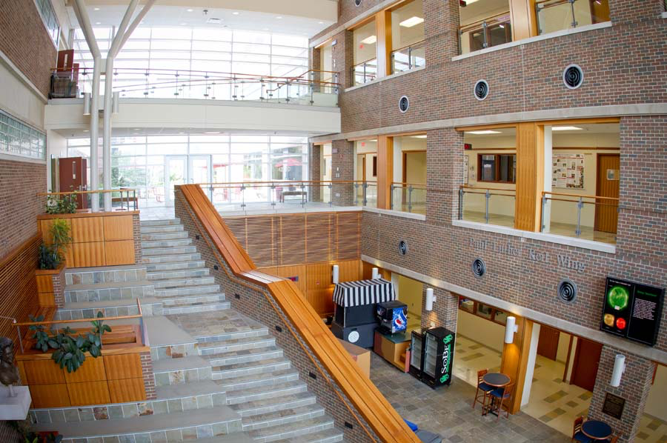
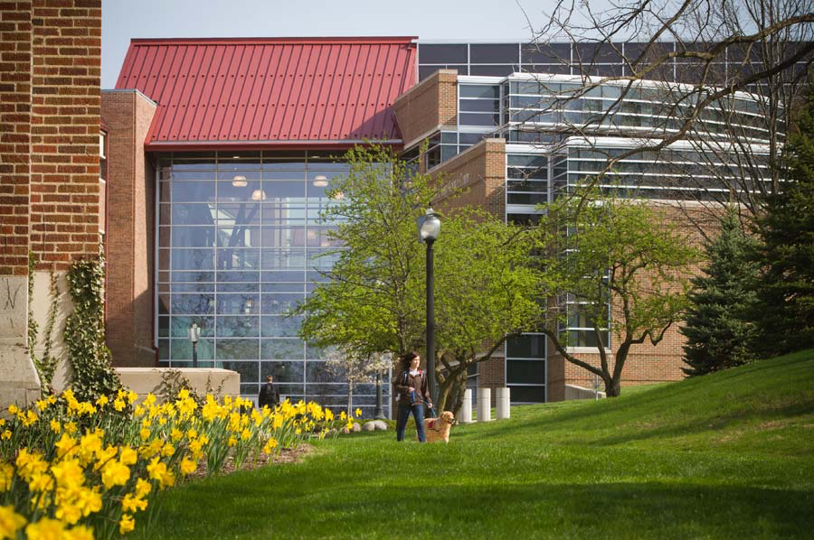
Where I Teach
Liberal arts college
Southwest Ohio
1800 students
~30 students in class
~80% biology / pre-health

Slide 3
Principles / Goals
Cover same content as lecture
Build important skills
  Reading
  Metacognition
  Critical thinking
  Teamwork / collaboration

Slide 4
Course Structure
Pre-class
Class
Post-class
Reading
Mini-lectures
Tutorials
Reflection
Clarification
Collaboration
Consolidation

Slide 5
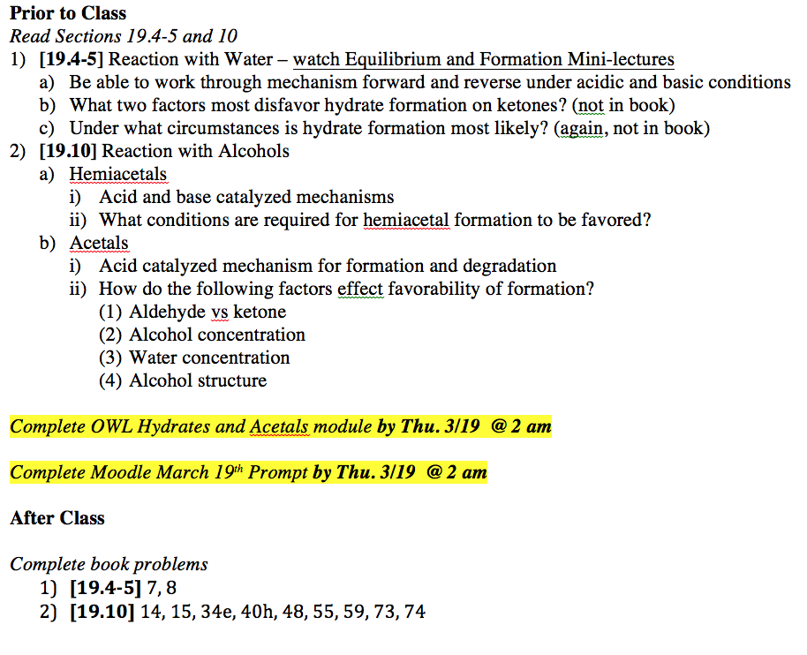
Pre-class

Slide 6
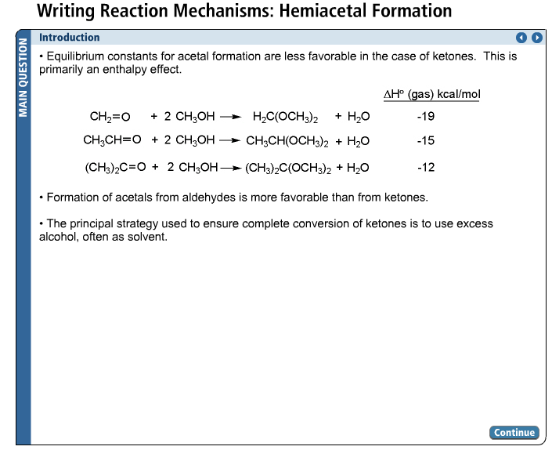
Pre-class

Slide 7
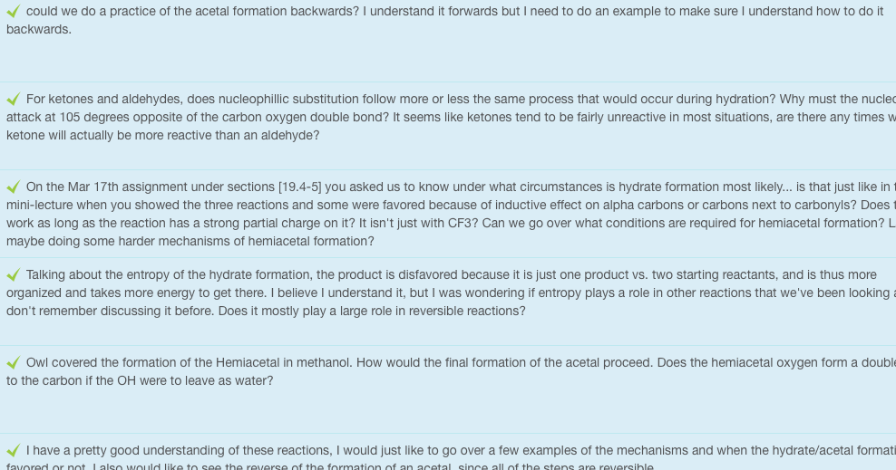
Pre-class – JiTT Question
What about the formation of hydrates and acetals would you most like to review in class tomorrow?

Slide 8
In class
Class
Clarification
Collaboration

Slide 9
In Class
Discuss JiTT prompt answers
Students work in groups
Review group solutions

Slide 10
[19.4,5,10] I would just like to go over a few examples of the mechanisms and when the hydrate/acetal formation is favored or not.
Sterics
Entropy - Talking about the entropy of the hydrate formation, the product is disfavored because it is just one product vs. two starting reactants, and is thus more organized and takes more energy to get there. I believe I understand it, but I was wondering if entropy plays a role in other reactions that we've been looking at? I don't remember discussing it before. Does it mostly play a large role in reversible reactions?
Concentration

Slide 11
Group Work
Teams of 3-4
Self-organized for each exam
  Reorganize with new people
Each person must contribute substantially once before anyone does so twice
Groups can earn extra credit on exam
Contributions worth 10% of course grade
  CATME – www.catme.org

Slide 12
Provide a mechanism and explain why products would be favored:
Acetals

Slide 13
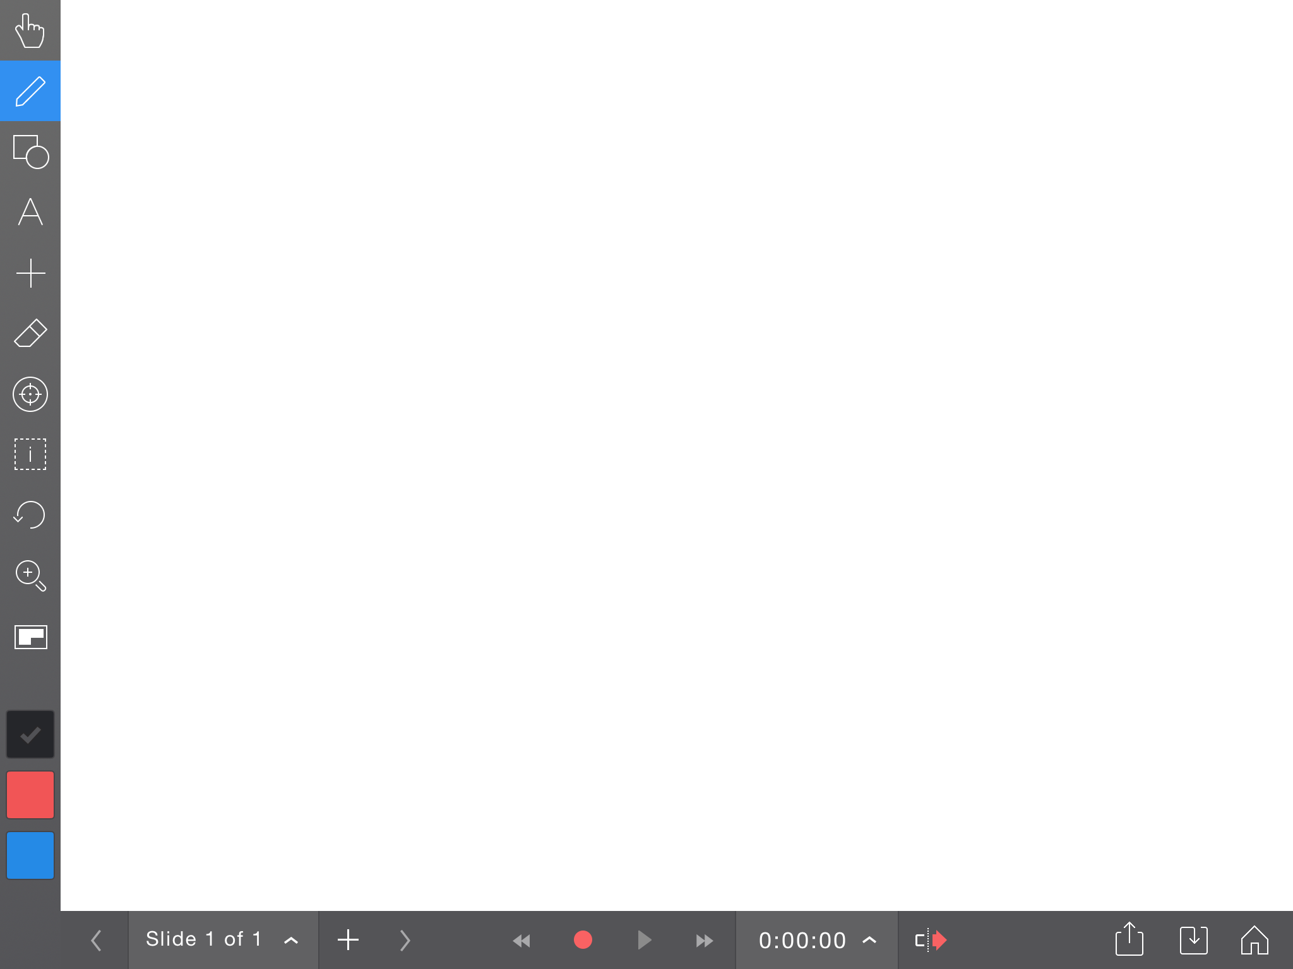
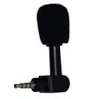
Explain Everything
Explain Everything (version 2.31) [Mobile Application Software]. Retrieved from http://itunes.apple.com

Slide 14
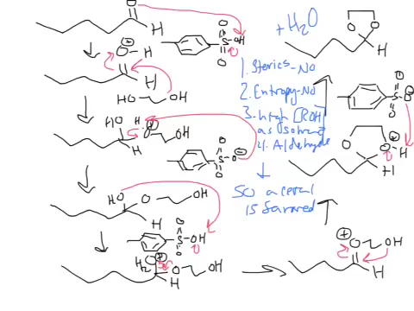
Provide a mechanism and explain why products would be favored:

Slide 15
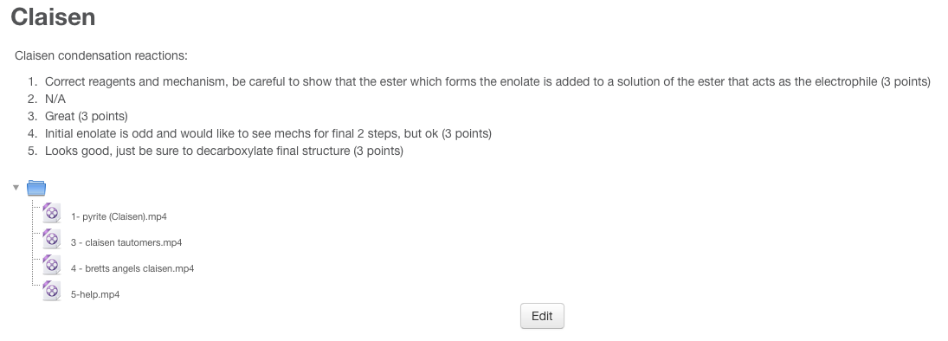
Moodle (version 2.5) [Website]. Retrieved from https://moodle.org.

Slide 16
Post class
Post Class
Consolidate

Slide 17
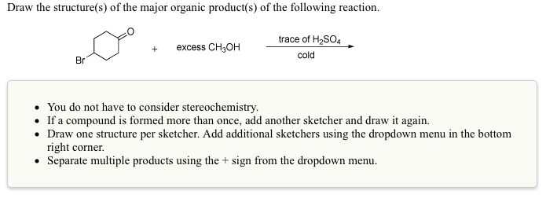
Post class

Slide 18
JiTT at Witt
Questions?
Justin Houseknecht, PhD
jhouseknecht@wittenberg.edu

