Slide 1
Just-In-Time Teaching at Wittenberg University
Active Learning in Organic Chemistry
Washington, D.C.
June 24, 2015
Justin Houseknecht, PhD

Slide 2
Overview
Pre-class
Class
Post-class
Reading
Tutorials
Reflection
Clarification
Collaboration
Consolidation

Slide 3
Pre-class
Pre-class
Review learning objectives
Read Go “Old School” with New Technology
Respond to forum post
Reading
Tutorials
Reflection

Slide 4
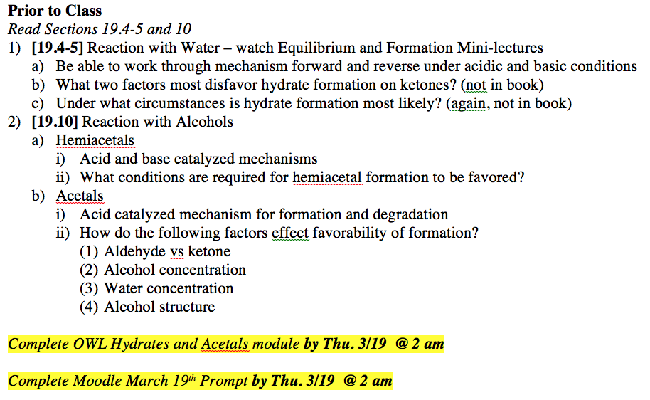
Pre-class
The hybrid JiTT approach incorporates a detailed list of learning objectives. Are these learning objectives created by the student, the instructor, or the textbook?

Slide 5
Pre-class
Is a detailed list of learning objectives given for each textbook chapter? If so, does it negatively impact a student's ability to determine what is important in reading and comprehending material, particularly in higher level chemistry courses or in real life?

Slide 6
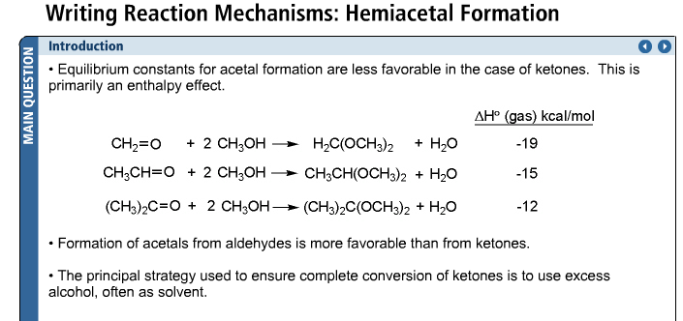
Pre-class
I would like to know more about the tutorial online homework assignments. 1) Did you create the tutorials … 2) Do students see topics for the first time in the tutorials? 3) Do the tutorials include problems that students are to attempt to solve on their own before class?

Slide 7
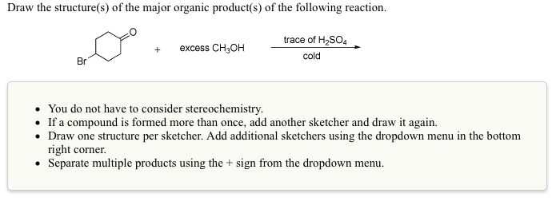
Pre-class
It seems that both the pre-class tutorial homework assignments and the post class ones due a week after class both come from OWL. Is there a difference in the type of questions that students are assigned before class and after class?

Slide 8
Pre-class
How do your students transmit to you the muddiest point question ie, how long before class and in what format?
How narrow or broad in scope are students' "muddiest point" questions/explanations expected to be?
How do you handle students who say that their muddiest point is 'everything'?

Slide 9
Pre-class
How long, in general, would you say students spend out of class time doing the pre-class activities?
What method is there of ensuring that students submit a "muddiest point" response? Do you get significant participation? I found last fall that my students gave up by the end of the semester because the response was optional, and that they often just said "online problem such-and-such gave me trouble."

Slide 10
In Class
Discuss JiTT prompt answers
Students work in groups
Review group solutions

Slide 11
In class
Class
Clarification
Collaboration

Slide 12
In class
What is different for the students, in class, between the hybrid JiTT and the flipped classes described by Vince and Bob?

Slide 13
In class
If you have a wide variety of “muddiest point” questions, how do you as the instructor decide which ones to have the students work on in class? Are the in class questions based on which “muddiest points” come up most frequent or which points you think are most critical for their learning experience?

Slide 14
Provide a mechanism and explain why products would be favored:
Acetals

Slide 15
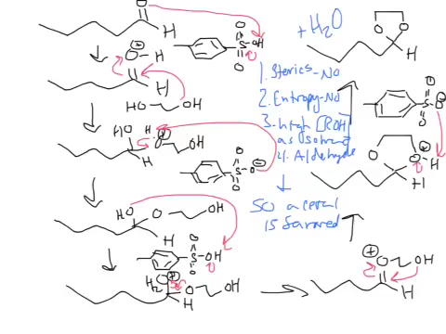
Provide a mechanism and explain why products would be favored:

Slide 16
In Class
How do manage the self-selected groups to stay on task and exercise restraint from socializing?

Slide 17
Post class
Post Class
Consolidate

Slide 18
Post class

Slide 19
Post class
Are there any after class activities that will allow them to continue working in groups?

Slide 20
Jitt at Witt
Questions?
Justin Houseknecht, PhD
jhouseknecht@wittenberg.edu

