Slide 1

Introducing Active Learning to Students and Colleagues
Jennifer Muzyka, Centre College
Active Learning in Organic Chemistry, 2015

Slide 2
How would you sell active learning to students?
Notes:
Participants will generate a list and I’ll write things on slide with Doceri

Slide 3
How would you sell active learning to students?
Start on first day of class
Mention pedagogical literature
Embrace mistakes
Share data on student performance (requires assessment & keeping track)
Notes:
My list – comment only on the items that workshop participants didn’t express

Slide 4
Thinking of what you want to get out of your college education and this course, which of the following is most important to you?
Acquiring information (facts, principles, concepts)
Learning how to use information and knowledge in new situations
Developing lifelong learning skills
Notes:
Clicker question used in first day of term for new classes. I show the response graph and we discuss. I tell students that all of these goals are important for me in this course. I think they’re surprised that I care about more than #1.

Slide 5
Of these three goals, which do you think you can make headway on outside of class by your own reading and studying?
Acquiring information (facts, principles, concepts)
Learning how to use information and knowledge in new situations
Developing lifelong learning skills
Notes:
Next clicker question, and then I tell students these ideas are why I teach the way I do, because I want to discuss the complicated examples in class. Reading quizzes provide more class time to enable that.

Slide 6
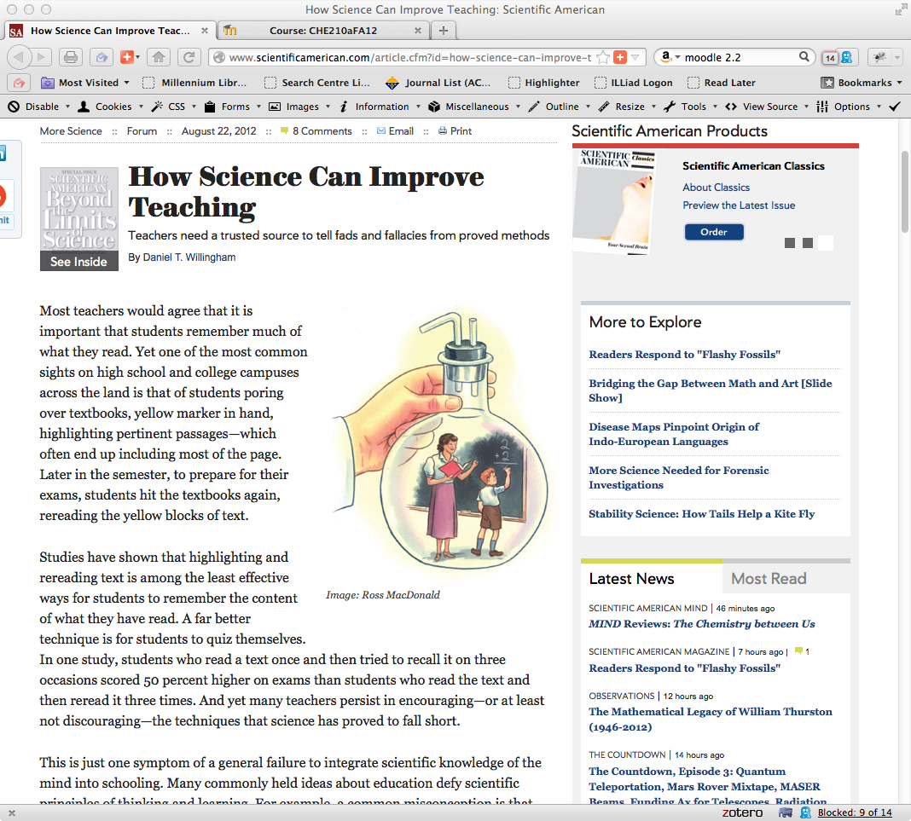
Notes:
Participants won’t be able to read screen. Students can’t either. The important point is that students are made aware that I read the pedagogical literature and try to follow the best practices.

Slide 7
The Last Lecture by Randy Pausch
Notes:
A real tear jerker of a book.

Slide 8

Notes:
There may be a predator in the water. The first penguin into the water may be giving his life for his friends. He dies, but the flock of penguins survives. Same thing with student questions and/or incorrect answers. When someone makes a mistake, the whole class can benefit from the incident.

Slide 9
Is anyone willing to be the first penguin?

Slide 10
Notes:
Students who answer questions incorrectly, ask important questions that reveal common misconceptions, or point out a mistake made by the instructor receive a penguin prize. These are representative examples – beach balls and super balls are big hits, as are rubber duckie penguins. Oriental Trading is a good source for cheap penguins.

Slide 11
How would you sell active learning to faculty colleagues?
Notes:
Participants will generate list of ideas and I will write them on screen with Doceri.

Slide 12
How would you sell active learning to faculty colleagues?
Share interesting articles you read
Visit colleague’s class, have them visit yours
Organize book discussion groups
Teaching workshops
Colorado SEI, www.colorado.edu/sei
Share data on student performance (requires assessment & keeping track)
Notes:
Not only colleagues in the chemistry department! Go to workshops taught by teaching and learning center, so you can meet others interested in these discussions. Visit the forums on OrganicERs. Go to BCCE (Colorado in 2016).

Slide 13
Resources
“First-Day Questions for the Learner-Centered Classroom,” Gary A. Smith, The National Teaching & Learning Forum, September 2008, 17 (5), 1-4.
The Last Lecture by Randy Pausch, Hachette Books, 2008.
Make it Stick: The Science of Successful Learning by Peter C. Brown et al, Belknap Press, 2014.
How Learning Works: Seven Research-Based Principles for Smart Teaching by Susan A. Ambrose et al, Jossey-Bass, 2010.
Oriental Trading, http://www.orientaltrading.com

Slide 14
Workshop Objectives
By the end of the workshop, participants will be better able to
describe the benefits of active learning.
align learning goals, assessments, and teaching activities.
apply at least two pedagogies/ technologies to enhance student learning outcomes.
recognize this community* as a resource to help you on your journey toward more active learning in the classroom.
* ALOC workshop participants and the Organic Education Resources (OrganicERs.org) virtual community

