Slide 1
Flipping with Video
A short description of how and why I record material for my students to view outside of class.
Cathy Welder, Dartmouth College
cCWCS – Active Learning in Organic Chemistry
Atlanta, June 13, 2017

Slide 2
Methods of Creating Videos: Livescribe pens
What are Livescribe pens and what can you do with them?
Livescribe Echo
Livescribe 3
Notes:
Livescribe Echo pens have a built-in camera, microphone, and memory and connect to a computer (Mac or PC). The pen can record audio and writing on special paper. Resulting pencast can be shared.
Livescribe 3 uses mic of tablet or phone and displays written material on screen of Android or iOS devices as you write.

Slide 3
How do we use the pens at Dartmouth?
Lecture Material
  Flipped classroom
  Remedial or tutorial topics
Answer Keys
  Quizzes
  Exams
  Problem sets
Data Sharing and Electronic Notebooks in Teaching Labs
Research Notebooks

Slide 4
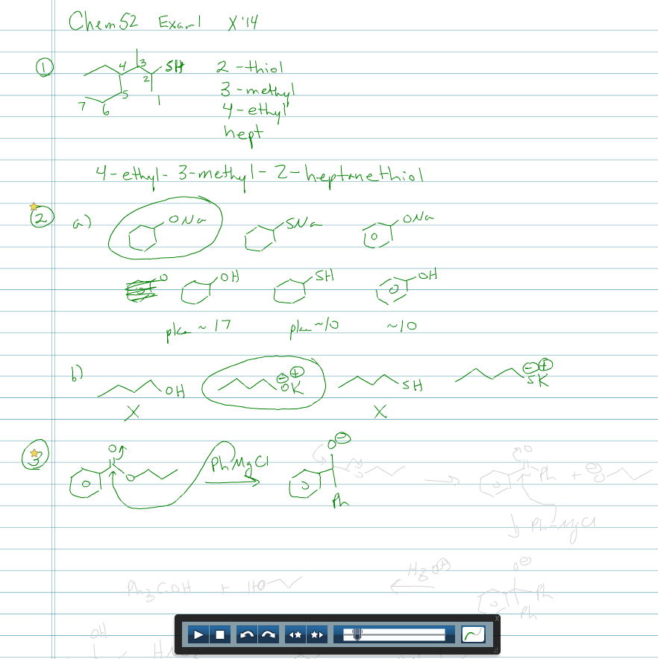
Methods of Creating Videos: Livescribe pens
Exam and quiz keys were written on paper with pen capturing strokes and audio.
Notes:
Software can recognize handwriting and the text is searchable.

Slide 5
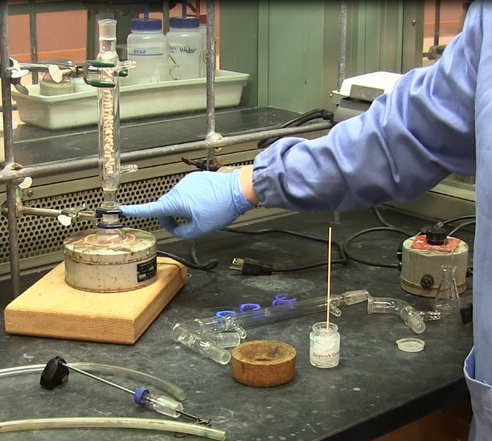
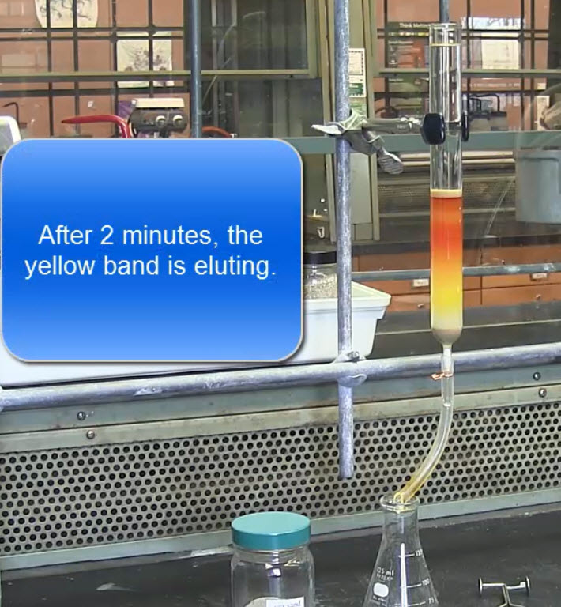
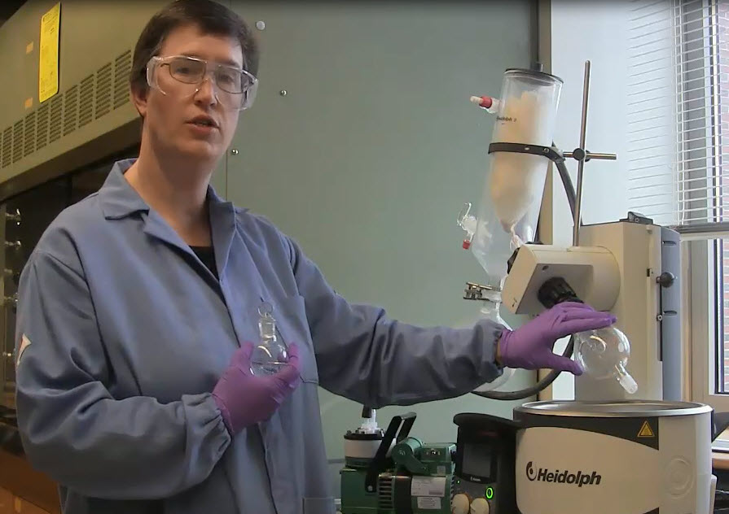
Methods of Creating Videos: Video Camera
Video camera and tripod were obtained from the library to record instrument demonstrations and setups.
Notes:
MP4 files were edited in Camtasia Studio which is now called TechSmith Camtasia. (iMovie works, too.) SnagIt is similar.

Slide 6
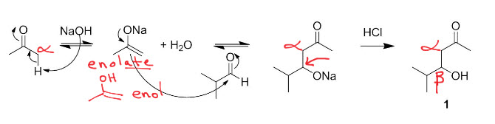
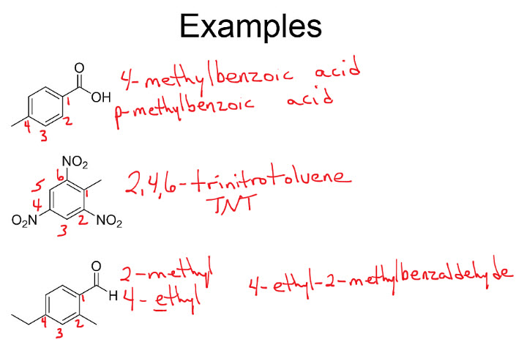
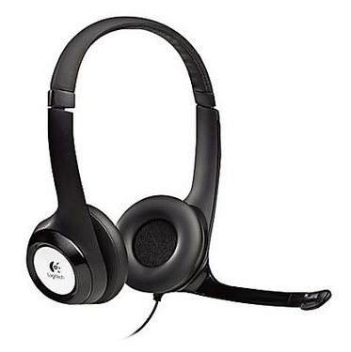
Methods of Creating Videos: Doceri with Camtasia Studio
PowerPoint presentations were annotated with Doceri and recorded via screen capture with Camtasia Studio.

Slide 7
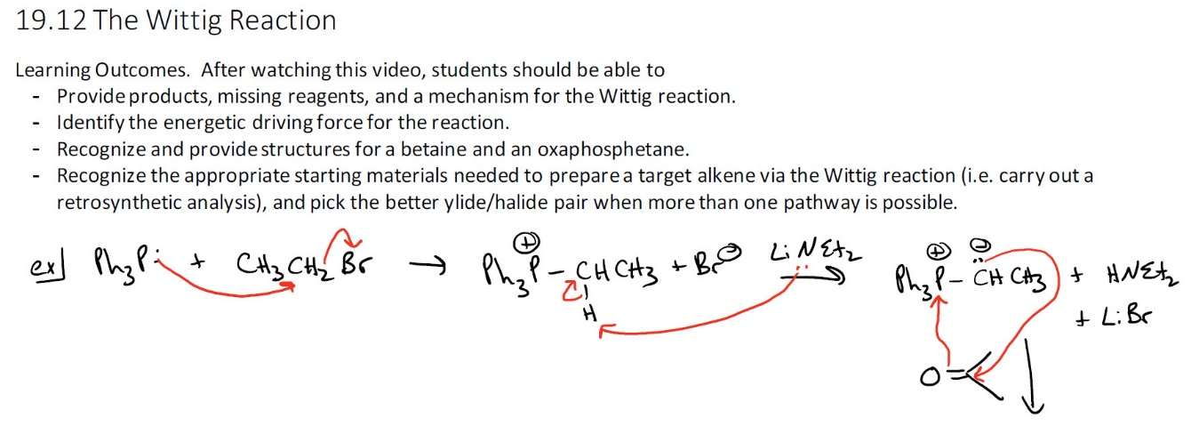
Methods of Creating Videos: OneNote with Camtasia Studio
Chalk talks were reproduced electronically by mirroring iPad to desktop (Airserver Connect) and using Camtasia Studio to screen capture writing in OneNote.
Notes:
Mirrored with Airserver Connect app. Used headset for better audio.

Slide 8
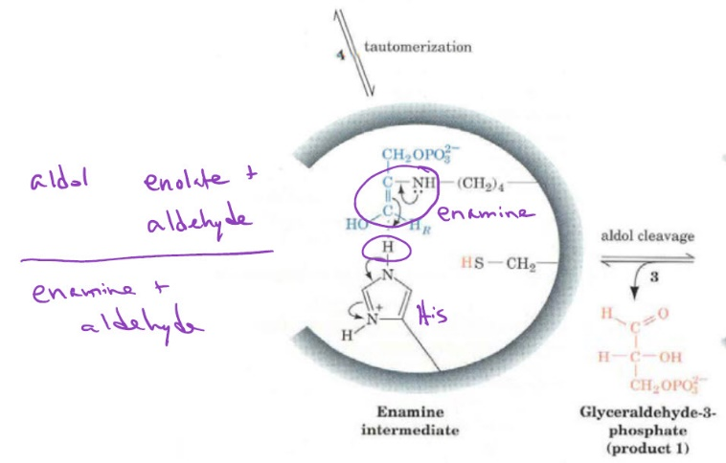
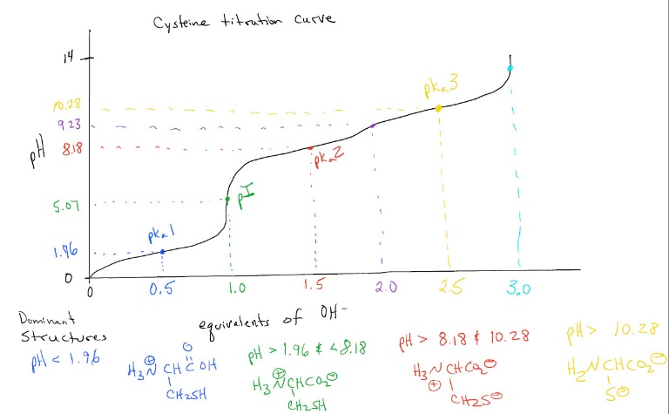
Methods of Creating Videos: OneNote with Camtasia Studio

Slide 9
Summary
Livescribe pens (for pen and paper)
Video camera (for lab demonstrations)
Doceri (for PowerPoint)
OneNote (for white board)
Notes:
Doceri can be used as a white board as well.

Slide 10
Questions?

Slide 11
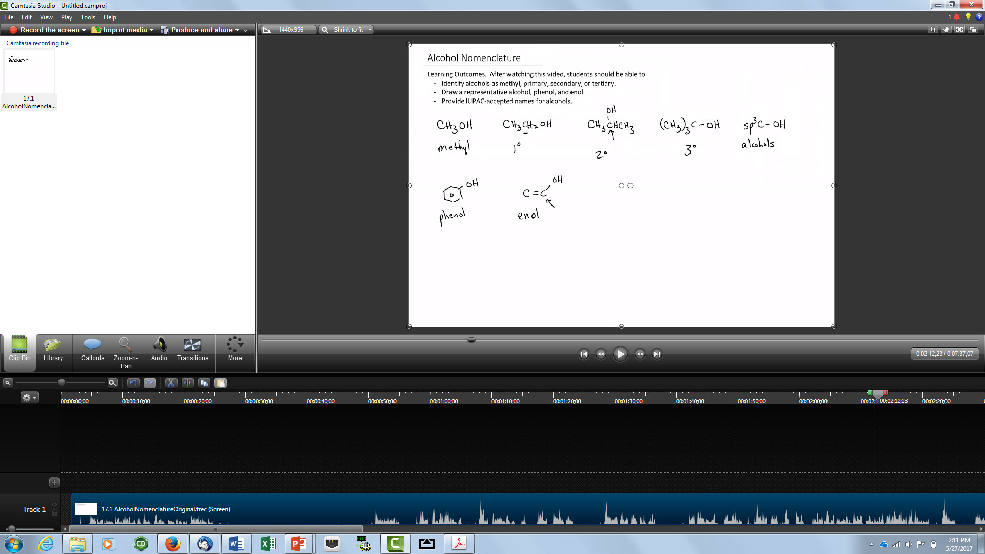
Camtasia Studio
Notes:
Only if time allows

