Slide 1

Flipping the Classroom
Bob Rossi
Associate Professor, Chemistry
Gloucester County College
cCWCS Workshop
“Active Learning in Organic Chemistry”– June 2014

Slide 2
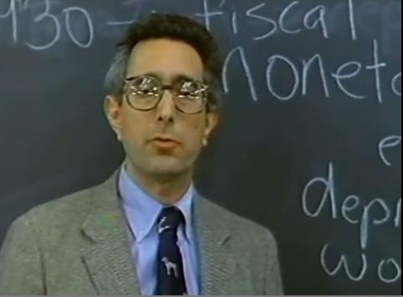
Why should I flip my classroom?

Slide 4



The Flipped Classroom Defined
Students practice applying key concepts with feedback
In-Class
Out-of-Class
Students prepare to participate in class activities
Students check their understanding and extend their learning

Slide 5
Facts About Flipping Your Classroom
Fact 1 - Flipped classroom – new term, old idea.
  Origins of the flipped classroom developed circa 1820’s or 1890’s.

Slide 6
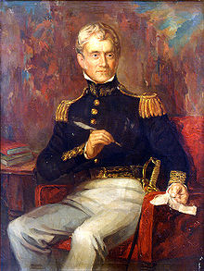
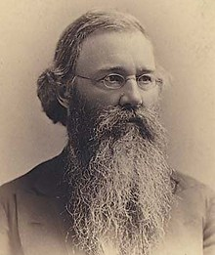
Sylvanus Thayer
Christopher Columbus Langdell
Dean of Harvard Law 1890’s Introduced the concept of “Case Study Method” aka “The Socratic Method”.
Superintendent U.S. Military Academy at West Point 1817
Developed the “Thayer Tenets of Education”

Slide 7
Facts About Flipping Your Classroom
Fact 1 - Flipped classroom – new term, old idea.
  Origins of the flipped classroom developed in circa 1820’s or 1890’s.
    Students take more responsibility for their own learning.
  Two recent seminal publications:
    Eric Mazur, Peer Instruction: Getting Students to Think in Class, American Institute of Physics Conference Proceedings, 1997.
    M. J. Lage, G. J. Platt, et. al, Inverting the Classroom: A Gateway to Creating an Inclusive Learning Environment, The Journal of Economic Education 31(1): 30-43, 2000
  Jonathan Bergmann and Aaron Sams, Flip Your Classroom, Reach Every Student in Every Class Every Day, 2007.
    K-12 implementation

Slide 8
Facts About Flipping Your Classroom
Fact 2 - A flipped classroom is an approach that can be implemented gradually or all at once.
  One concept
  One chapter
  One section
  One lab
  One class meeting per week
  One course

Slide 9
Facts About Flipping Your Classroom
Fact 3 - Flipped classrooms do not replace faculty with technology.
  Flipped classrooms are about pedagogy.
  Three key objectives:
    Lift content coverage out of the class,
    Employ privileged content and application in-class,
    Find ways to motivate continued learning after class.

Slide 10
Facts About Flipping Your Classroom
Fact 4 - Flipped classrooms direct attention away from the teacher and redirects it back to the students.
  Instructor goes from lecturer to learning facilitator (“From Sage on the Stage to Guide on the Side” ⃰ ).
  You can flip your class many ways:
    Video capture
    Just-in-Time Teaching (JiTT)
    Pencasting with Livescribe Pens
    Combinations of the above
⃰⃰ Alison King, College Teaching,41(1),30-35,1993

Slide 11
Facts About Flipping Your Classroom
Fact 5 - Flipped classrooms leverage how people learn best.
  We always learn best when we have some prior content knowledge.
    Let’s run an experiment!

Slide 12
Experiment 1 – Study these letters for 5 seconds, don’t write anything down.
J FKFB INAT OUP SNA SAI RS

Slide 13
Times up!
Write down what you remember.

Slide 14
Experiment 2 – Study these letters for 5 seconds, don’t write anything down.
JFK FBI NATO UPS NASA IRS

Slide 15
Times up!
Write down what you remember.
Bet you remembered at lot more!

Slide 16
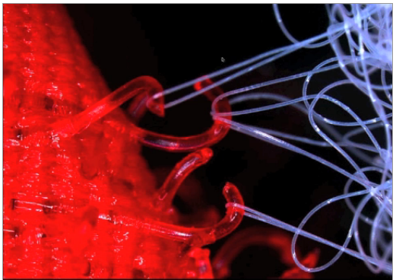
Velcro Theory of Memory

Slide 17
Facts About Flipping Your Classroom
Fact 5 - Flipped classrooms leverage how people learn best.
  We always learn best when we have some prior content knowledge.
  We learn best when we apply our content knowledge.

Slide 18
Think about something you know really well, something you are considered an expert in.
How did you learn that so well?
By doing it! Practicing it! → Applying it!
“Practice at retrieving new knowledge or skill from memory is a potent tool for learning and durable retention”, P.C. Brown, H. L. Roediger, M. A. McDaniel

Slide 19
Facts About Flipping Your Classroom
Fact 5 - Flipped classrooms leverage how people learn best.
  We always learn best when we have some prior content knowledge.
  We learn best when we apply our content knowledge.
    For students to remember they need lots of practice with retrieving.

Slide 20
Facts About Flipping Your Classroom
Fact 5 - Flipped classrooms leverage how people learn best.
  We always learn best when we have some prior content knowledge.
  We learn best when we apply our content knowledge.
    For students to remember they need lots of practice with retrieving.
  Flipped classroom helps develop higher-order thinking skills by doing applications in class.

Slide 21
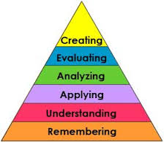
Bloom’s Taxonomy
Traditional Classroom
Flipped Classroom
Outside of Class
In Class
In Class
Outside of Class

Slide 22
Facts About Flipping Your Classroom
Fact 6 - Challenges
  Significant time investment required up-front, but more efficient over time.
  Will take several iterations to get it right.
  Flipped classrooms are not the cure all.
    Students must prepare outside class.
    Student pushback to doing coursework outside of class.
  Make sure assessments cover out-of-class assignments.
    Great use of clicker questions!

Slide 23

Facts About Flipping Your Classroom
Just a few words of CAUTION!
  Some students may resist flipped learning.
    Lecture acts as a security blanket for some students.
  Remedy:
    Lecture a little every class period.
  Avoid the terms like “Flipped Classroom” or calling your class an experiment.

Slide 24
Suggested Readings
“Case Studies and the Flipped Classroom”, C. F. Herreid and N. A. Schiller, J. of College Science Teaching, 42,5, 2013, 62.
“Inverted (Flipping) Classrooms – Advantages and Challenges, Mason, G., Shuman, T. R., et al., 2013, ASEE, Atlanta, GA.
“The Flipped Classroom – A Survey of the Research”, Bishop, J. L., and Embry-Riddle, M. A. V., American Society for Engineering Education, 2013.
“How ‘Flipping’ the Classroom Can Improve the Traditional Lecture”, Berret, D., The Chronicle of Higher Education, February 19, 2012.
Ron Kordyban and Shelley Kinash. (2013) "No more flying on autopilot: The flipped classroom“ Education Technology Solutions, 56, 54-56: ISSN 1835-209X, http://epublications.bond.edu.au/tls/66

Slide 25
Suggested Websites
http://my.brainshark.com/Flipped-Classrooms-101-An-Introduction-to-Flipped-Learning-712355288
https://www.khanacademy.org/science/organic-chemistry
http://flippedlearning.org/
http://flippedclassroom.org
http://confchem.ccce.divched.org/2014SpringConfChem

Slide 26
How I “Flipped” My Organic Classes
Technology Used
Video Lecture Topics and Assignment
Use of Classroom Face-to-Face Time
Student Outcomes
Student Survey and Comments

Slide 27
How I “Flipped” My Organic Classes
Technology Used
  “Khan” style video
    Modeled after the Khan Academy videos
    Student sees a “blackboard” background with colored “chalk” writing
    Hear only the instructors voice
    Videos can readily be prepared using a PC with some additional hardware and software
  Example:
    Introduction to Chirality (6:45) http://media.collegeanywhere.org/view/content/15415

Slide 28
How I “Flipped” My Organic Classes
Technology Used
  Screen Capture Software
    Snagit (TechSmith)
    Camtasia (TechSmith)
    Jing (freeware, http://www.techsmith.com/jing.html)
    FrontCam (freeware, http://frontcam.com/)
  Digital Free-Hand Drawing Software
    SmoothDraw (freeware, http://www.smoothdraw.com/product/)
  Video editing software
    Video file conversion (e.g., avi to wma or mp4)
    Easy Media Creator 9 (Roxio)
  USB tablet with stylus or touch-screen computer
    Bamboo model CTH-470 (Wacom)
  Host server to house video lectures
    CollegeAnywhere (www.collegeanywhere.org )

Slide 29
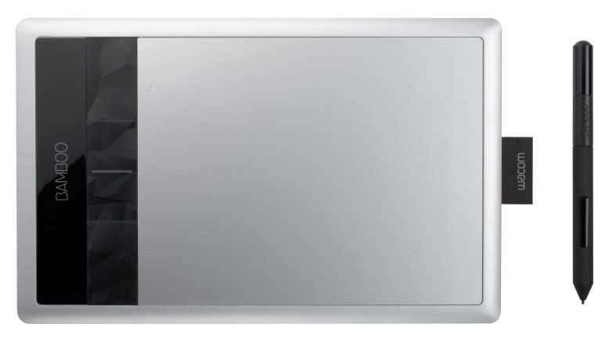
Bamboo Model CTH-470 (Wacom)

Slide 30
How I “Flipped” My Organic Classes
Technology Used
  Screen Capture Software
    Snagit (TechSmith)
    Camtasia (TechSmith)
    Jing (freeware, http://www.techsmith.com/jing.html)
    FrontCam (freeware, http://frontcam.com/)
  Digital Free-Hand Drawing Software
    SmoothDraw (freeware, http://www.smoothdraw.com/product/)
  Video editing software
    Video file conversion (e.g., avi to wma or mp4)
    Easy Media Creator 9 (Roxio)
  USB tablet with stylus or touch-screen computer
    Bamboo model CTH-470 (Wacom)
  Host server to house video lectures
    CollegeAnywhere (www.collegeanywhere.org )

Slide 31
How I “Flipped” My Organic Classes
Video Lecture Topics and Assignment
  Created >340 video “Lecture-On-Demand” topics to cover the two semester sequence of Organic Chemistry
    Organic I – 43 hrs.
    Organic II – 45 hrs.
  Organized generically by topic and arranged by chapter of text in use
    Each topic typically between 10 and 20 minutes length
    Video lectures were typically assigned to the class in approximately 2.5 to 3 hour segments per week
  Videos available to student on PC’s (Windows and Mac) and most mobile devices by direct URL or through E-Learning (Blackboard) link to CollegeAnywhere
    iPad users – supplied link to Google Doc published to the web

Slide 32
How I “Flipped” My Organic Classes
Video Lecture Topics and Assignment
Organic Chemistry I
Video Lecture Topic | Video Length (minutes:seconds)
Introduction to Hydrocarbons http://media.collegeanywhere.org/view/content/15844 | 14:11
Counting Hydrogens on Carbon in a Skeletal Structure http://media.collegeanywhere.org/view/content/15393 | 5:16
Introduction to the Rules of Resonance http://media.collegeanywhere.org/view/content/16885 | 12:32
Summary of Allowed Electron Movements in Resonance http://media.collegeanywhere.org/view/content/15489 | 13:12
Introduction of Organic Reactions http://media.collegeanywhere.org/view/content/15667 | 16:20
Introduction to Ionic Nucleophilic Substitution http://media.collegeanywhere.org/view/content/15876 | 23:58
Organic Chemistry II
Introduction to Conjugated Systems http://media.collegeanywhere.org/view/content/16029 | 15:49
UV Spectroscopy – The Basics http://media.collegeanywhere.org/view/content/16050 | 27:06
Electrophilic Aromatic Substitution – Nitration http://media.collegeanywhere.org/view/content/15991 | 10:23
Friedel – Crafts Acylation – Some Further Comments http://media.collegeanywhere.org/view/content/15995 | 8:44
The Nature of the Carbonyl Group http://media.collegeanywhere.org/view/content/15906 | 5:49

Slide 33
How I “Flipped” My Organic Classes
Use of Classroom Face-to-Face Time
  Typically start class with question and answer session based on key concepts presented in the videos.
    incorporated iClicker questions.
  Proceed to give a “mini-lecture” reviewing those concepts that were obvious trouble spots.
  Problem solving portion of the class time handled in a collaborative team/peer learning format
    instructor now a “coach” roaming from team to team to answer questions, lend support/guidance as needed and engage in deeper concept discussions.

Slide 34
Student Outcomes

Slide 35
Student Outcomes

Slide 36
Student Outcomes

Slide 37
Student Outcomes

Slide 38
Student Outcomes

Slide 39
Student Survey Results – Organic I

Slide 40
Student Survey Results – Organic I

Slide 41
Student Survey Results – Organic I

Slide 42
Student Survey Results – Organic II

Slide 43
Student Survey Results – Organic II

Slide 44
Student Survey Results – Organic II

Slide 45
Student Comments – Organic I
“The lectures on demand were useful, and I suggest that they should be kept up for future students.”
“Any chemistry course is tough enough as it is. However the video lectures, coupled with in class problem sets have made it easy for me to learn. I can't imagine taking this course any differently now.”
“Love the video's, they were great! I really enjoy this course a lot. Can't wait from Organic II next semester.”

Slide 46
Student Comments – Organic II
“The style and format of this course this semester was very helpful. I was able to look back at videos as well as compare with the text. It helped me with the problems and exams.”
“Great course. I really liked the online lectures. It helped me to better understand and learn the material. Also doing homework in class helped better understand the reactions.”
“The on-demand lectures were a great idea because you could re-watch them as many times as necessary. The in-class problems were a huge help because they are very similar in style to the test questions.”

