Slide 1
Collaborative Learning Techniques
Active Learning in Organic Chemistry
Atlanta, Georgia
June 13, 2017
Justin Houseknecht, PhD

Slide 2
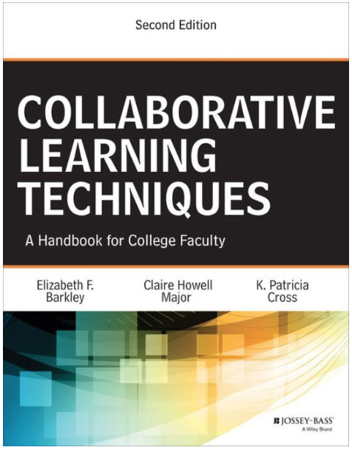


Resources

Slide 3
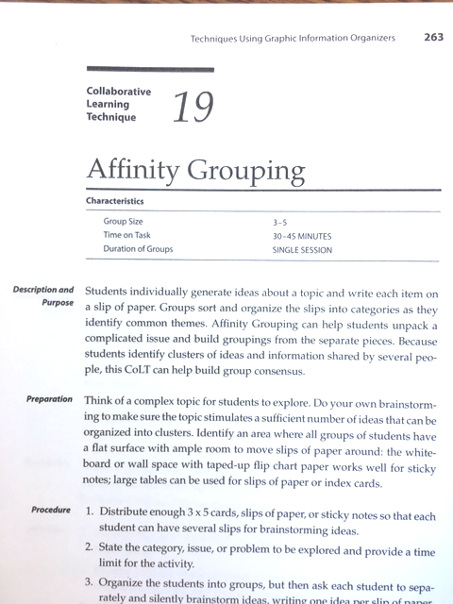
Collaborative Learning Techniques
Description / purpose
Preparation
Procedure
Examples
Variations
Observations / advice
Resources

Slide 4
Collaborative Learning Techniques
CoLT #1 – Think-Pair-Share
  Also Think-Pair-Square
CoLT #2 – Round Robin (#25 Round Table)
CoLT #7 – Note-Taking Pairs
CoLT #11 – Jigsaw
CoLT #13 – Think-Aloud Pair Problem-Solving (TAPPS)
CoLT #16 – Structured Problem Solving
CoLT #19 – Affinity Grouping
Notes:
1 – Alexey’s Monday evening session
2 – JBH’s Tuesday morning JiTT session
7 –
11 – Alexey’s Wednesday morning CAT session
13 –
19 – JBH’s Tuesday morning JiTT sesion

Slide 5
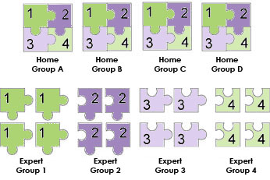
Jigsaw
http://edtech2.boisestate.edu/reilleyd/502/jigsaw.html

