Slide 1
Workshop Overview,
Backward Design, and
Generating Learning Outcomes
Cathy Welder, Dartmouth College
cCWCS – Active Learning in Organic Chemistry
Washington, D.C., June 22, 2015

Slide 2
Workshop Overview
Why we think active learning is best
What we are doing
How we are doing it
Give it a try! (Hands on with the technology)
Question, discuss, and network
Reflect (What you will implement?)

Slide 3
Workshop Objectives
By the end of the workshop, participants will be better able to
describe the benefits of active learning.
align learning goals, assessments, and teaching activities.
apply at least two pedagogies/ technologies to enhance student learning outcomes.
recognize this community* as a resource to help you on your journey toward more active learning in the classroom.
* ALOC workshop participants and the Organic Education Resources (OrganicERs.org) virtual community

Slide 4
Outline
By the end of this presentation, you will be better able to
define backward design.
identify the 3 stages of backward design.
construct and critique learning outcomes.

Slide 5
How do you design your course?

Slide 6
What is Backward Design?
From the Scientific Teaching lexicon:
“Designing instructional materials by first setting learning goals, and then designing classroom activities so that students meet the goals.”
From Understanding by Design (UbD):
Think first about specific learnings sought, and the evidence of such learnings, before thinking about teaching and learning activities.

Slide 7
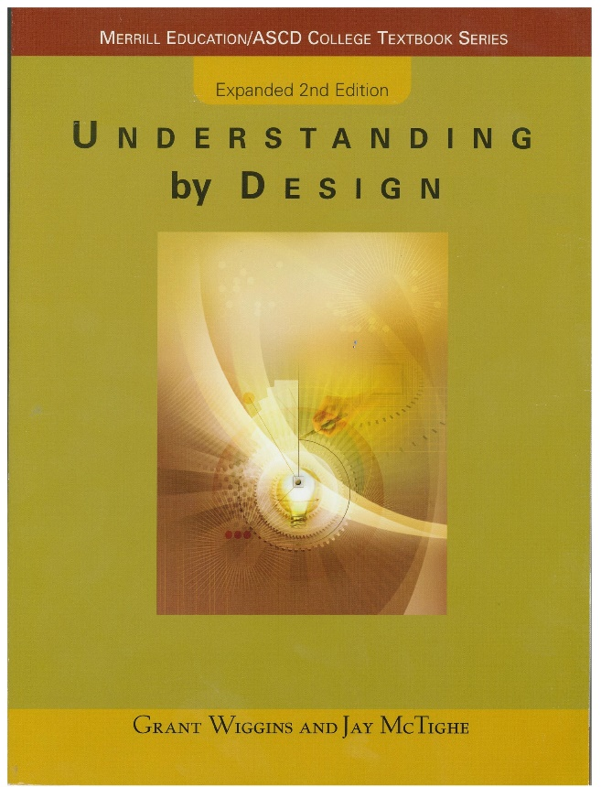
Stages of Backward Design
1. Identify desired results. (goals/objectives/outcomes)
  2. Determine acceptable evidence. (assessment)
  3. Plan learning experiences and instruction (activities)
Notes:
Retrosynthetic arrows! When designing a synthesis, we often take a retrosynthetic approach. Backward design uses similar concepts. Start at the target and figure out how to get there.

Slide 8
Advantages of learning outcomes

Slide 9
Creating Learning Goals
At the end of the course, students should be able to …
Goals should
convey relevance and usefulness.
be observable and measurable.
use everyday language and minimize technical jargon.
use descriptive verbs. (Avoid “understand.”)
be aligned with the level of learning that you expect of students.

Slide 10
Creating Learning Goals
By the end of class, students should understand the reaction of alcohols with HX.
Professor thinks … | Student thinks …

Slide 11
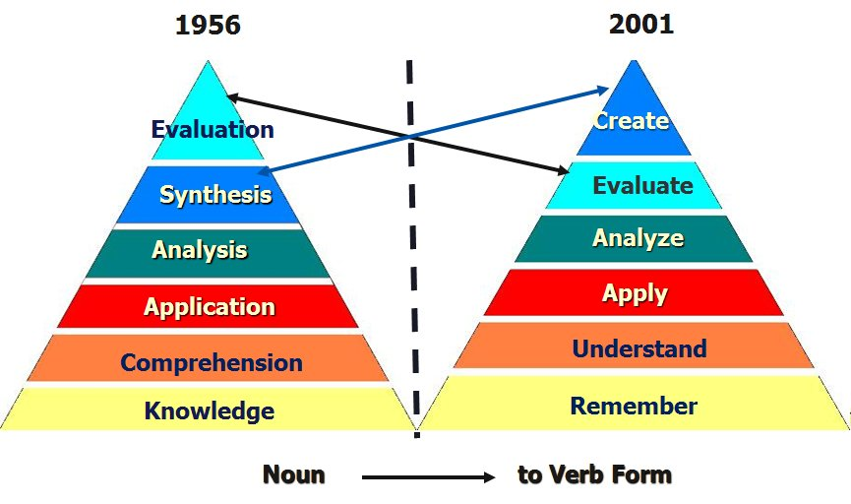
Bloom’s Taxonomy
Bloom vs. Anderson/Krathwohl
Higher-level Tasks
Cognitive Tasks
Lower-level Tasks
Anderson, L.W. and Krathwohl (Eds.) A Taxonomy for Learning, Teaching and Assessing: a Revision of Bloom’s Taxonomy of Educational Objectives. Longman, New York, 2001.
Notes:
Bloom’s taxonomy of the cognitive domain outlines different cognitive levels.

Slide 12
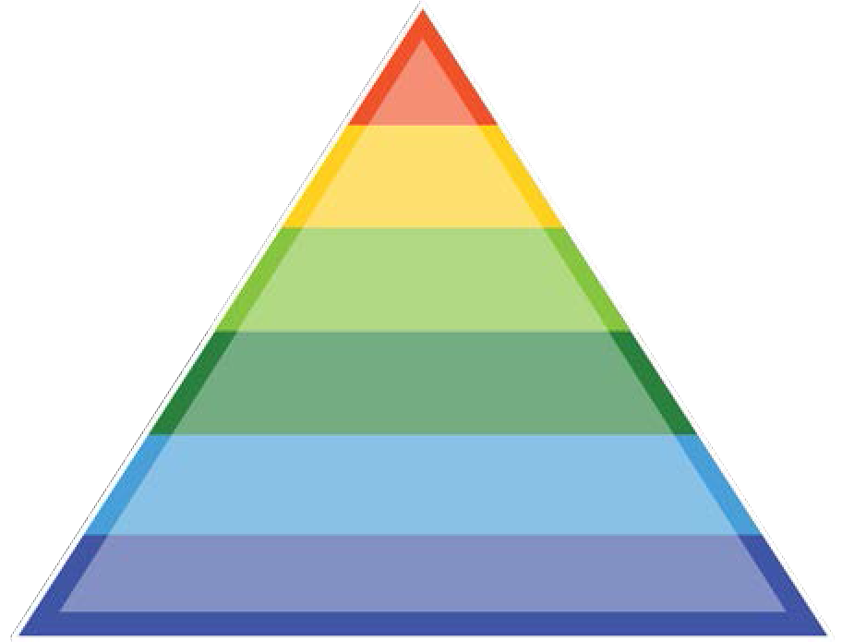
Bloom’s (Revised) Taxonomy
Can the student …
create
evaluate
analyze
apply
understand
remember
Produce new or original work? Design, assemble, construct, develop, formulate, author, investigate
Justify a stand or decision? Appraise, argue, defend, judge, select, support, value, critique, weigh
Draw connections among ideas? Differentiate, organize, relate, compare, contrast, distinguish, examine, experiment, question, test
Use information in new setting? Execute, implement, solve, use, demonstrate, interpret, operate, schedule, sketch
Explain ideas or concepts? Classify, describe, discuss, explain, identify, locate, recognize, report, select, translate
Recall facts and basic concepts? Define, duplicate, list, memorize, repeat, state
from the Coursera MOOC, An Introduction to Evidence-Based Undergraduate STEM Teaching

Slide 13
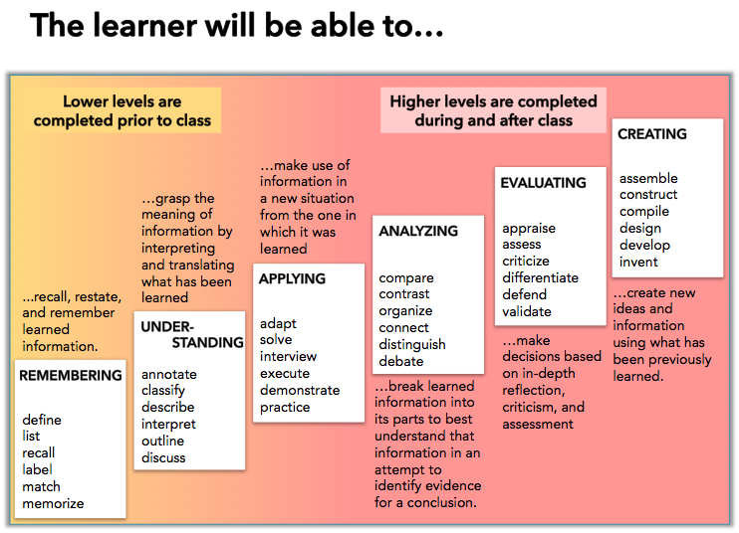

Slide 14
Creating Learning Goals
What types of knowledge do you want students to gain?
Facts
Concepts
Procedures
Metacognition (how you learn)
Affective (attitudes and beliefs)
Notes:
Metacognition - self awareness about what helps you learn; studying and learning strategies
Affective - Appreciate, enjoy, value. (Recognize that the behavior of the world around you is not magical and mysterious, but rather can be understood and predicted using certain fundamental principles.)
Facts – terminology, information, details.
Concepts – classifications, categories, principles, models, reasoning (analyze, explain, and predict the world around you)
Procedures – skills, techniques, methods, problem-solving. (Thinking like a scientist: Use alternative representations, compare and contrast, strategize, justify, design an experiment, create a graph.)

Slide 15
Creating Learning Goals
Consider
Cognitive level
Types of knowledge
Scope:
  Course-level learning goals
    Broad, overarching
    A few per course
    What do you want them to know from your course 5 yrs. from now?
  Topic-level learning objectives
    More specific
    Several per topic
    Aligned with course-level learning goals

Slide 16
Example Learning Goal and Objectives
Course-Level Goal
You should be able to synthesize a given target from small organic molecules and any inorganic reagents you need. (Any organometallic reagents you wish to use would need to be synthesized.)
Topic Level Objectives
After completing Ch. 19 students should be able to:
  Synthesize phosphorus ylides from alkyl halides.
  Synthesize alkenes using the Wittig reaction of a phosphorus ylide with an aldehyde or ketone.

Slide 17
Example Topic-Level Learning Objective
Audience
Behavior (verbs)
Condition
Degree of mastery (optional)
After completing Ch. 19 students should be able to synthesize phosphorus ylides from alkyl halides.
Notes:
Student friendly? Concise? Observable? Measureable?

Slide 18
Creating Learning Goals
How do I begin?
Someone else’s goals
End of chapter summaries
Unpack an exam question
Write one course-level learning goal and at least one topic-level learning objective that align with each other.
Notes:
Bloom’s = levels of knowledge

Slide 19
Check-list for creating class-scale learning goals:
Is goal expressed in terms of what the student will achieve or be able to do?
Is the Bloom’s level of the goal aligned with your actual expectations?
Is the goal well-defined? Is it clear how you would measure achievement?
Do chosen verbs have a clear meaning?
Is terminology familiar/common? If not, is the terminology a goal?
Is it relevant and useful to students? (e.g. connected to their everyday life OR does it represent a useful application of the ideas).
http://www.colorado.edu/sei/fac-resources/workshops-clickers-materials-LG.htm (accessed 5/21/15)

Slide 20
Acknowledgements
Instructional Designers
  *Adrienne Gauthier*
  Adam Nemeroff
  Scott Millspaugh
Dartmouth Center for the Advancement of Learning (DCAL)
  Cindy Tobery
  Prue Merton

Slide 21
References
Handelsman, J., Miller, S., and Pfund, C. Scientific Teaching; W.H. Freeman: New York, 2007.
Wiggins, G. and McTighe, J. Understanding by Design, 2nd ed.; Pearson: New Jersey, 2006.
Bruff, D., McMahon, T., Goldberg, B., Campa III, H., An Introduction to Evidence-Based Undergraduate STEM Teaching, https://class.coursera.org/stemteaching-001 accessed 5/12/2015
The Carl Weiman Science Education Initiative http://cwsei.ubc.ca and http://colorado.edu/sei

