Slide 1
Workshop Overview,
Backward Design, and
Generating Learning Outcomes
Cathy Welder, Dartmouth College
cCWCS – Active Learning in Organic Chemistry
Cincinnati, June 20, 2016

Slide 2
Workshop Overview
Why we think active learning is best
What we are doing
How we are doing it
Give it a try! (Hands on with the technology)
Question, discuss, and network
Reflect (What you will implement?)

Slide 3
Workshop Objectives
By the end of the workshop, participants will be better able to
describe the benefits of active learning.
align learning goals, assessments, and teaching activities.
apply at least two pedagogies/technologies to enhance student learning outcomes.
recognize this community* as a resource to help you on your journey toward more active learning in the classroom.
* ALOC workshop participants and the Organic Education Resources (OrganicERs.org) virtual community

Slide 4
Outline
By the end of this presentation, you will be better able to
define backward design.
identify the 3 stages of backward design.
construct and critique learning outcomes.

Slide 5
How do you design your course?
Notes:
Fishing for Pick content, Pick Labs, pick HW and exam problems, lecture content, pick activities (such as “This is an awesome lab that we must do.”), just start writing notes
(Next slide intro) If we don’t think about goals or desired learning outcomes, then this is our approach to teaching.

Slide 6
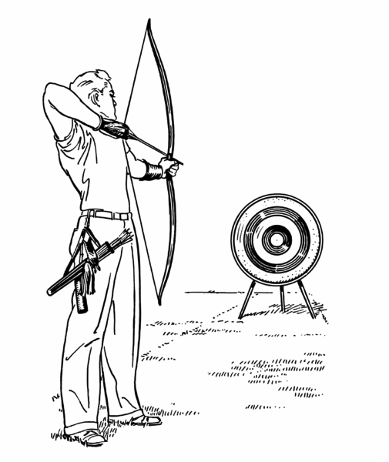
Instruction without goals….
Ready?
Fire!
Aim.
University of Colorado Boulder Science Education Initiative
http://www.colorado.edu/sei/fac-resources/workshops-clickers-materials-LG.htm (accessed 5/21/15)

Slide 7
What is Backward Design?
From the Scientific Teaching lexicon:
“Designing instructional materials by first setting learning goals, and then designing classroom activities so that students meet the goals.”
From Understanding by Design (UbD):
Think first about specific learnings sought, and the evidence of such learnings, before thinking about teaching and learning activities.

Slide 8
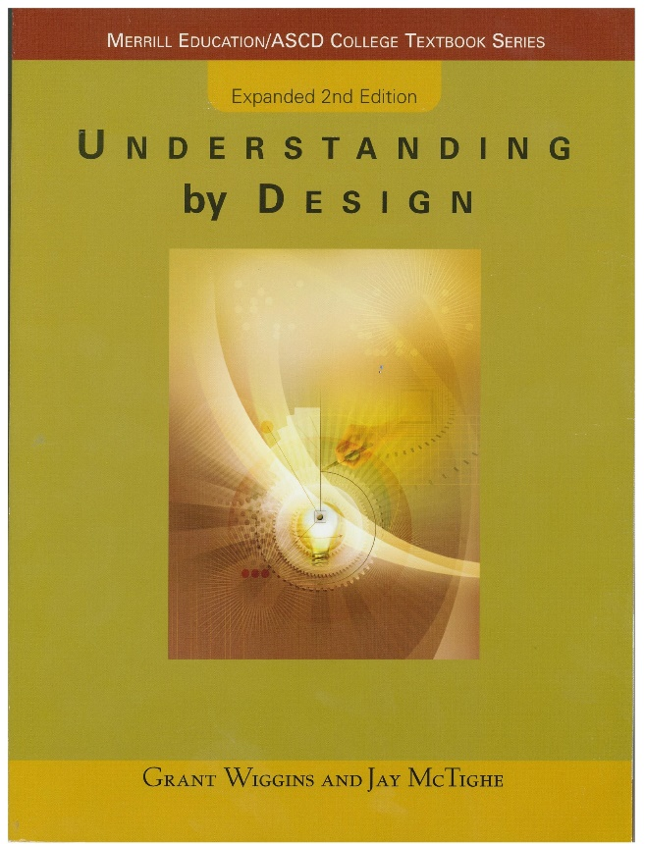
Stages of Backward Design
1. Identify desired results. (goals/objectives/outcomes)
  2. Determine acceptable evidence. (assessment)
  3. Plan learning experiences and instruction (activities)
Notes:
Retrosynthetic arrows! When designing a synthesis, we often take a retrosynthetic approach. Backward design uses similar concepts. Start at the target and figure out how to get there.

Slide 9
Advantages of learning outcomes
Notes:
Wait for answers then show next slide. Prompt for both faculty and student benefits.

Slide 10
Why Learning Goals?
Student Benefits | Instructor Benefits
Know what is expected | Teach what really matters.
Focused, more productive study time | Write homework, exams, and design instruction at an appropriate level.
Assess themselves | Align your course with other courses.
Learning goals are different than a list of topics to be covered.
Notes:
More material doesn’t equal more learning. UBD refers to twin sins = too much content/too many activities

Slide 11
Creating Learning Goals
At the end of the course, students should be able to …
Goals should
convey relevance and usefulness.
be observable and measurable.
use everyday language and minimize technical jargon.
use descriptive verbs. (Avoid “understand.”)
be aligned with the level of learning that you expect of students.
Notes:
Create performance tasks that explicitly list what the learner should be able to do.
At the end of the course or Before the first exam or In 5 years …

Slide 12
Creating Learning Goals
By the end of class, students should understand the reaction of alcohols with HX.
What’s a better way to phrase the learning goal?
By the end of class, students should be able to
  draw the products of the reaction of a 2º or 3º alcohol with HX.
  provide a complete electron-pushing mechanism and a reaction energy diagram that shows the relative energies and structures of starting materials, transition states, intermediates, and products.
  explain why the reaction doesn’t work well for methyl or 1º alcohols.
Professor thinks … | Student thinks …
Notes:
Prof – give products, mechanism, rxn E diagram, effect of rxn condition changes
Student – give the product of a reaction
Bloom’s taxonomy helps you write better Learning Outcomes.

Slide 13
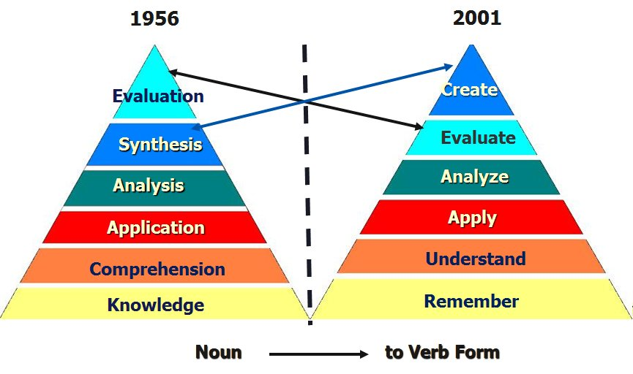
Bloom’s Taxonomy
Bloom vs. Anderson/Krathwohl
Higher-level Tasks
Cognitive Tasks
Lower-level Tasks
Anderson, L.W. and Krathwohl (Eds.) A Taxonomy for Learning, Teaching and Assessing: a Revision of Bloom’s Taxonomy of Educational Objectives. Longman, New York, 2001.
Notes:
Bloom’s taxonomy of the cognitive domain outlines different cognitive levels.

Slide 14
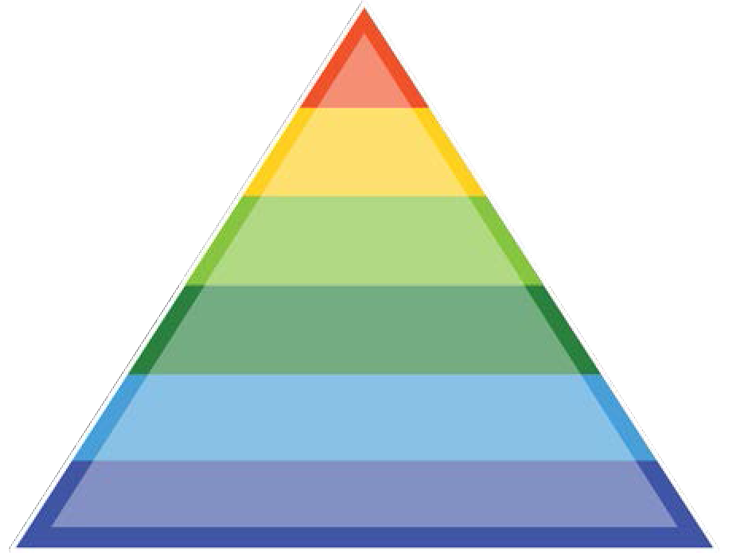
Bloom’s (Revised) Taxonomy
Can the student …
create
evaluate
analyze
apply
understand
remember
Produce new or original work? Design, assemble, construct, develop, formulate, author, investigate
Justify a stand or decision? Appraise, argue, defend, judge, select, support, value, critique, weigh
Draw connections among ideas? Differentiate, organize, relate, compare, contrast, distinguish, examine, experiment, question, test
Use information in new setting? Execute, implement, solve, use, demonstrate, interpret, operate, schedule, sketch
Explain ideas or concepts? Classify, describe, discuss, explain, identify, locate, recognize, report, select, translate
Recall facts and basic concepts? Define, duplicate, list, memorize, repeat, state
from the Coursera MOOC, An Introduction to Evidence-Based Undergraduate STEM Teaching
Notes:
Apply – transfer info (1-BuOH vs 1-PrOH example)
Analyze – draw connections by grouping reagents or reaction types: oxidizers, C-C bond forming rxns, etc
Evaluate – This reaction sequence will not give the indicated product. Why not? (Step requires S_{N}2 on 3º halide or organometallic but acidic H.)
Create – Multi-step synthesis

Slide 15
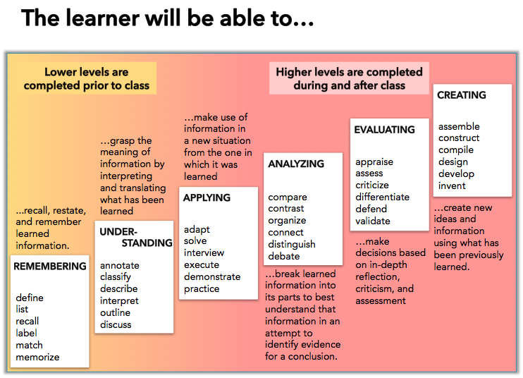
Notes:
See additional verbs in handout.

Slide 16
Creating Learning Goals
What types of knowledge do you want students to gain?
Facts (terminology)
Concepts (categories and reasoning)
Procedures (skills and problem-solving)
Metacognition (how you learn)
Affective (attitudes and beliefs)
Notes:
Metacognition - self awareness about what helps you learn; studying and learning strategies
Affective - Appreciate, enjoy, value. (Recognize that the behavior of the world around you is not magical and mysterious, but rather can be understood and predicted using certain fundamental principles.)
Facts – terminology, information, details.
Concepts – classifications, categories, principles, models, reasoning (analyze, explain, and predict the world around you)
Procedures – skills, techniques, methods, problem-solving. (Thinking like a scientist: Use alternative representations, compare and contrast, strategize, justify, design an experiment, create a graph.)

Slide 17
Creating Learning Goals
Consider
Cognitive level
Types of knowledge
  facts, concepts, procedures, metacognition, affective
Scope:
  Course-level learning goals
    Broad, overarching
    A few per course
    What do you want them to know from your course 5 yrs. from now?
  Topic-level learning objectives
    More specific
    Several per topic
    Aligned with course-level learning goals

Slide 18
Example Learning Goal and Objectives
Course-Level Goal
You should be able to synthesize a given target from small organic molecules and any inorganic reagents you need. (Any organometallic reagents you wish to use would need to be synthesized.)
Topic Level Objectives
After completing Ch. 19 students should be able to:
  Synthesize phosphorus ylides from alkyl halides.
  Synthesize alkenes using the Wittig reaction of a phosphorus ylide with an aldehyde or ketone.
Notes:
Let’s break the first topic-level objective into its components.

Slide 19
Example Topic-Level Learning Objective
Audience
Behavior (verbs)
Condition
Degree of mastery (optional)
After completing Ch. 19 students should be able to synthesize phosphorus ylides from alkyl halides.
Notes:
Student friendly? Concise? Observable? Measureable?

Slide 20
Example Course-Level Learning Goals
For chapters 16-24, you should be able to
provide electron-pushing mechanisms for most of the reactions we cover. This includes using isotopes such as D, ¹³C, and ¹⁸O to show explicitly where bond changes occur.
predict products of reactions or provide missing reagents if given one or more starting materials and the final product.
fill in missing reagents in a reaction sequence.
convert a given starting material to a given product, showing any intermediate compounds, in a small number of specified steps (often 2 or 3).
synthesize a given target from small organic molecules and any inorganic reagents you need. (Any organometallic reagents you wish to use would need to be synthesized.)
interpret and predict IR, ¹H NMR, and ¹³C NMR spectra of organic molecules.
Notes:
I’m missing metacognition and affective domain goals.

Slide 21
Creating Learning Goals
How do I begin?
Someone else’s goals
End of chapter summaries
Unpack an exam question
Write one course-level learning goal and at least one topic-level learning objective that align with each other.
Notes:
Bloom’s = levels of knowledge
Suggested area – your topic of focus for the workshop

Slide 22
Check-list for creating class-scale learning goals:
Is goal expressed in terms of what the student will achieve or be able to do?
Is the Bloom’s level of the goal aligned with your actual expectations?
Is the goal well-defined? Is it clear how you would measure achievement?
Do chosen verbs have a clear meaning?
Is terminology familiar/common? If not, is the terminology a goal?
Is it relevant and useful to students? (e.g. connected to their everyday life OR does it represent a useful application of the ideas).
http://www.colorado.edu/sei/fac-resources/workshops-clickers-materials-LG.htm (accessed 5/21/15)

Slide 23
Share your Learning Goal/Objectives
Pass your learning goal and objective to another group.
Can you re-write the goal or objective to a higher Bloom’s level?
Can you write a question that would assess whether or not the desired level of learning has occurred?
Notes:
Share/discuss.

Slide 24
Acknowledgements
Instructional Designers
  *Adrienne Gauthier*
  Adam Nemeroff
  Scott Millspaugh
Dartmouth Center for the Advancement of Learning (DCAL)
  Cindy Tobery
  Prue Merton

Slide 25
References
Handelsman, J., Miller, S., and Pfund, C. Scientific Teaching; W.H. Freeman: New York, 2007.
Wiggins, G. and McTighe, J. Understanding by Design, 2nd ed.; Pearson: New Jersey, 2006.
Bruff, D., McMahon, T., Goldberg, B., Campa III, H., An Introduction to Evidence-Based Undergraduate STEM Teaching. See www.cirtl.net for more information.
The Carl Weiman Science Education Initiative http://cwsei.ubc.ca and http://colorado.edu/sei

