Slide 1
Active Learning Pedagogies
An Overview
Bob Rossi
Active Learning in Organic Chemistry Workshop
June 20-23, 2015 – Cincinnati, OH

Slide 2
“Tell me and I forget. Teach me and I remember. Involve me and I learn.”
Benjamin Franklin

Slide 3
What is Active Learning?
Passive Learning
Active Learning
During class instructor delivers course content by giving a “lecture”.
Students sits passively and listen to the instructor, taking notes on what is believed important.
Instructor may intersperse questions during lecture, which are typically answered by select few students.
Instructor assigns problems from the text for students to do for homework on their own.
Class time spent engaging students in answering and asking questions, thinking about and solving problems, and explaining and reflecting on what they are learning.
Course content is delivered to students outside of class time, as homework.
During class (and outside class) students work in groups/teams (peer-to-peer learning).

Slide 4
Key Features of Active Learning
  Instructor goes from lecturer to learning facilitator
    “From Sage on the Stage to Guide on the Side”.
  Students take on more responsibility for their learning.

Slide 5
Why Active Learning?
Active learning leverages how people learn best.
  We always learn best when we have some prior content knowledge.

Slide 6
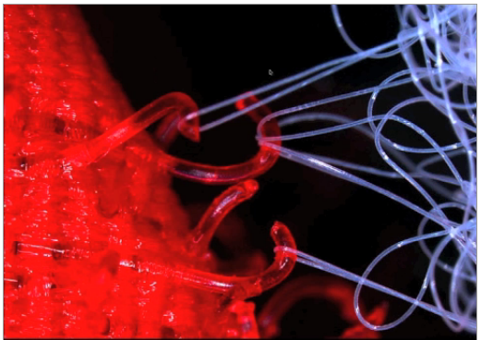
Velcro Theory of Memory/Learning
Donovan, M.S., Bransford, J.D. How Students Learn: Science in the Classroom, National Academies Press, 2005

Slide 7
Why Active Learning?
Active learning leverages how people learn best.
  We always learn best when we have some prior content knowledge.
  We learn best when we apply our content knowledge.

Slide 8
How did you learn something well?
By doing it! Practicing it! → Applying it!
High-quality Study Techniques*:
  Regularly scheduled training in the subject,
  Training tasks designed by an expert teacher,
  Ongoing (formative) feedback from an expert teacher during training tasks,
  Intense concentration during training with minimal distractions.
*Plant, E. A., et. al., Contemporary Educational Psychology 30(1): 96-116 (2005).

Slide 9
Why Active Learning?
Active learning leverages how people learn best.
  We always learn best when we have some prior content knowledge.
  We learn best when we apply our content knowledge.
  Helps develop higher-order thinking skills by doing applications in class.

Slide 10
Bloom’s Taxonomy
Passive Learning Classroom
Active Learning Classroom
Creating
Outside of Class
Evaluating
In Class
Analyzing
Applying
Understanding
In Class
Outside of Class
Remembering

Slide 11
Why Active Learning?
Active learning leverages how people learn best.
  We always learn best when we have some prior content knowledge.
  We learn best when we apply our content knowledge.
  Helps develop higher-order thinking skills by doing applications in class.
  Peer-to-peer interactions help reinforce what is learned.

Slide 12
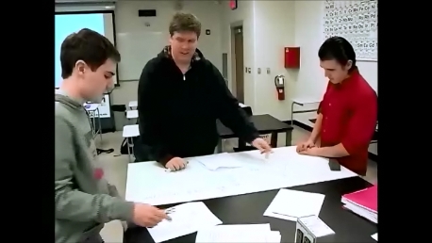
“Studies of chemistry education during the past decade demonstrate that various forms of socially mediated learning (in which students create meaning through interactions with others) produce positive outcomes, including significantly higher test scores, higher final grades, better conceptual understanding, lower course withdrawal rates, and positive impacts on attitudes”*
*Kober, Nancy. Reaching Students: What Research Says About Effective Instruction in Undergraduate Science and Engineering. National Academies Press, 2015, p14.

Slide 13
Peer-to-Peer Learning Promotes:
Critical thinking, problem solving, and decision-making skills.
Exchanges that enhance reasoning and higher order thinking.
Cognitive and metacognitive processes.
Perspective taking and accommodation to others’ ideas.
Acceptance an encouragement within the group.
Greater student – teacher interaction, improved formative assessment.

Slide 14
Promising Practices*
Prepare a set of learning outcomes.
Organize students in small groups.
Provide students with feedback through systematic formative assessment.
Design in-class activities to actively engage students.
Faculty-initiated approaches to student-faculty interactions.
*N. Nielsen, “Promising Practices in Undergraduate Science, Technology, Engineering, and Mathematics Education: Summary of Two Workshops”, Proceedings of the National Academy of Sciences, 2011.

Slide 15
Active Learning Pedagogies
Video capture – Flipped Classroom
Lecture/clicker tutorials
Case studies
Pre-class screencasts/worksheets
Peer Instruction
Just-in-Time Teaching (JiTT)
Pencasting
Combinations of the above

Slide 16
Why is this Important?
  The President's Council of Advisors on Science and Technology* (PCAST):
    Called for a 34% increase in the number of STEM bachelor’s degrees completed per year over the next 10 years.
    Recommended adoption of empirically validated teaching practices as critical to achieving that goal.
*Olson, Steve, and Donna Gerardi Riordan. "Engage to Excel: Producing One Million Additional College Graduates with Degrees in Science, Technology, Engineering, and Mathematics. Report to the President." Executive Office of the President (2012).

Slide 17
STEM Major Retention Crisis*
>50% of students who intend to major in a STEM field switch to a different major in college, many in the first semester.
Percentage is even higher for community college students - 14 % degree completion.
* S. Olson, ”Community Colleges in the Evolving STEM Education Landscape: Summary of a Summit”, Proceedings of the National Academy of Sciences, 2012.

Slide 18
Is Active Learning Effective?
  Recent study* of active learning vs. traditional lecture:
    Meta-analyzed 225 studies that reported data on exam scores and failure rates in undergraduate STEM courses.
    Results show three key outcomes:
      Average exam scores increased by 6% in active learning sections (increase of half a letter grade).
      Scores on concept inventories increased by almost 1 SD.
      Students in traditional lecture sections were 1.5 times more likely to fail.
    Results were evident across all class sizes.
      Greatest impact with class sizes of ≤ 50.
    Key recommendations:
      Traditional lecture no longer the benchmark.
      Compare different active learning methods and amounts.
*S. Freeman, et. al., “Active learning increases student performance in science, technology,
and mathematics”, Proceedings of the National Academy of Sciences, 111(23), 8410-8415, 2014

Slide 19
Is Active Learning Effective?
0.441
Exam
N = 109
Assessment Type
0.883
Concept
Inventory
N = 22
0.0 0.3 0.6 0.9
Hedges’s g
(Effect Size)

Slide 20
Is Active Learning Effective?
Undergraduate biochemistry course at Columbia University*.
Created 4 groups – 28 students/group.
  Group 1 – textbook, lecture
  Group 2 – video, lecture
  Group 3 – textbook, problem solving
  Group 4 – video, problem solving
Study impact on attendance and exam scores.
* Stockwell, B.R., et. al., Cell, 162, August 27, 2015, Elsevier, Inc.

Slide 21
Is Active Learning Effective?
Findings –
  Twice as many students chose not to attend class after receiving a textbook assignment (33%), vs. a video assignment (16%).
    Video is a more engaging way to present content?
  Significant improvement in satisfaction with preparation material among students receiving video assignment.
  Median exam scores increased from group 1 through group 4 (61%, 67%, 73%, 80%).
  Students who listened to lecture underperformed those who actively solved problems during class.
* Stockwell, B.R., et. al., Cell, 162, August 27, 2015, Elsevier, Inc.

Slide 22
Is Active Learning Effective?
Study from the Department of Biology, BYU*.
Goal – specifically determine the impact of “flipping” on learning gains.
Two sections - active learning flipped vs active learning non-flipped.
Approximately 54 students/section
Active learning pedagogy used:
  Bybee’s 5E learning cycle (Engage, Explore, Explain, Elaborate, Evaluate)
*Jensen, J. L., et.al., CBE—Life Sciences Education, 14,1-12, Spring 2015

Slide 23
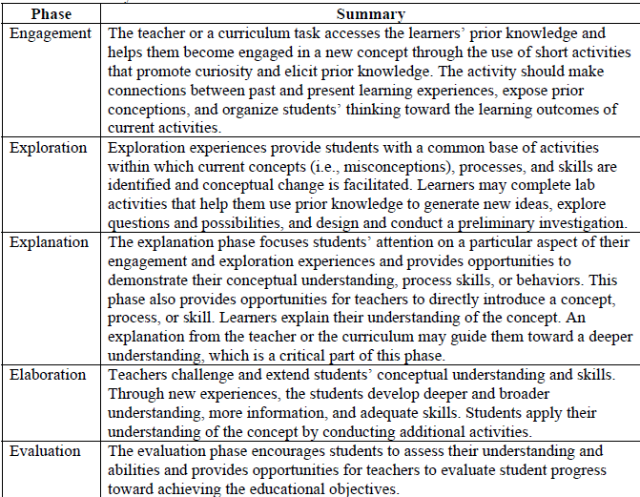
Bybee’s 5E Instructional Model*
*Bybee, R., et.al., The BSCS 5E Instructional Model: Origins, Effectiveness, and Applications,
http://www.bscs.org/sites/default/files/_legacy/BSCS_5E_Instructional_Model-Executive_Summary_0.pdf

Slide 24
Is Active Learning Effective?
Study design:

Slide 25
Is Active Learning Effective?
Key findings:
  Flipped classroom does not result in higher learning gains or better attitudes.
  Any learning gains seen historically are likely the result of active learning style of instruction.
*Jensen, J. L., et.al., CBE—Life Sciences Education, 14,1-12, Spring 2015

Slide 26
Is Active Learning Effective?
Northern Arizona U. study
  Partially flipped vs. fully flipped genetics/evolution course.
  Background material presentation:
    Before class - fully flipped.
    During class - partially flipped.
  Problem sets used in class as active learning component.
  No significant differences in learning outcomes.
*Adams, A., et.al., CBE—Life Sciences Education, 15,1-9, Summer 2016

Slide 27
Is Active Learning Effective?
M. Seery reviewed the results of 12 recent published reports on flipped classrooms*.
Common outcomes found:
  Students enjoy and engage with the format.
  Performance outcomes were similar, if not better, than traditional approaches.
  Evidence that retention is better.
*Seery, M., Chem. Educ. Res. Pract., DOI: 10.1039/c5rp00136f

Slide 28
Why Is Active Learning Effective?
  University of Massachusetts* studied reasons for increased student performance with active learning vs a standard course format.
  Physical Chemistry course required for Biochemistry majors.
  Key Findings – substantial positive differences in student approach to the flipped format:
    Better prepared for class - avoided cramming.
    Complete online assignments more accurately.
*Gross, D., et.al., CBE—Life Sciences Education, 14,1-8, Winter 2015

Slide 29
Welcome and Enjoy the Workshop!

